Slide 1

90-Day Interim Superintendent Report
Board of Education Meeting
December 10, 2024
Dr. Carol Montague-Davis
Interim Superintendent
Dr. Carol Montague-Davis
Interim Superintendent
CHAMPIONS
for Children
with kindness!

Slide 2
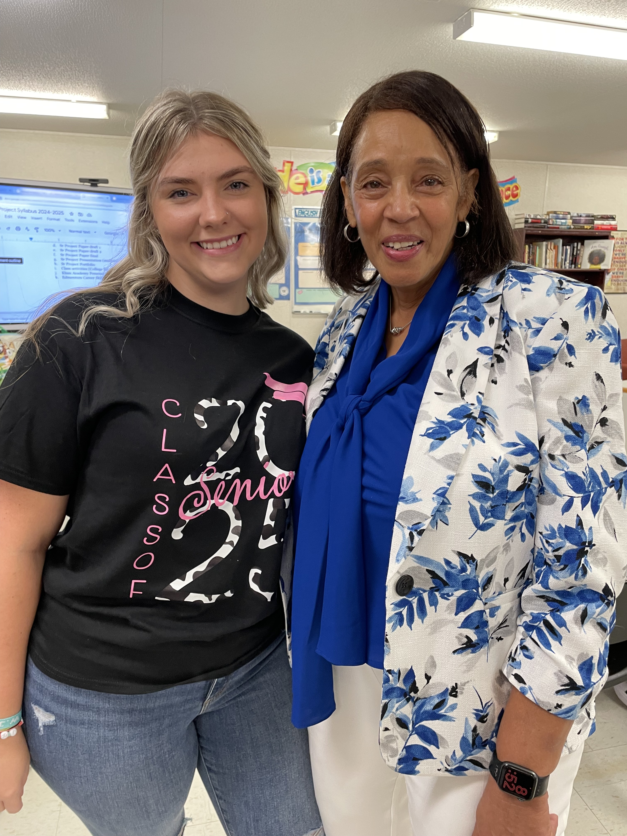
Agenda
Core Values and Vision
30, 60, 90-Day Overview
Key Actions and Outcomes by Focus Area
Next Steps and Strategic Goals
CHAMPIONS
for Children
2|
with kindness!

Slide 3

Core Values and Vision
Core Values
Trust, Integrity, Teamwork, Collaboration, Equity, Success, Accountability
Vision
Every student has the right to a high-quality education that meets their individual needs and prepares them for lifelong success.
CHAMPIONS
for Children
3|
with kindness!

Slide 4
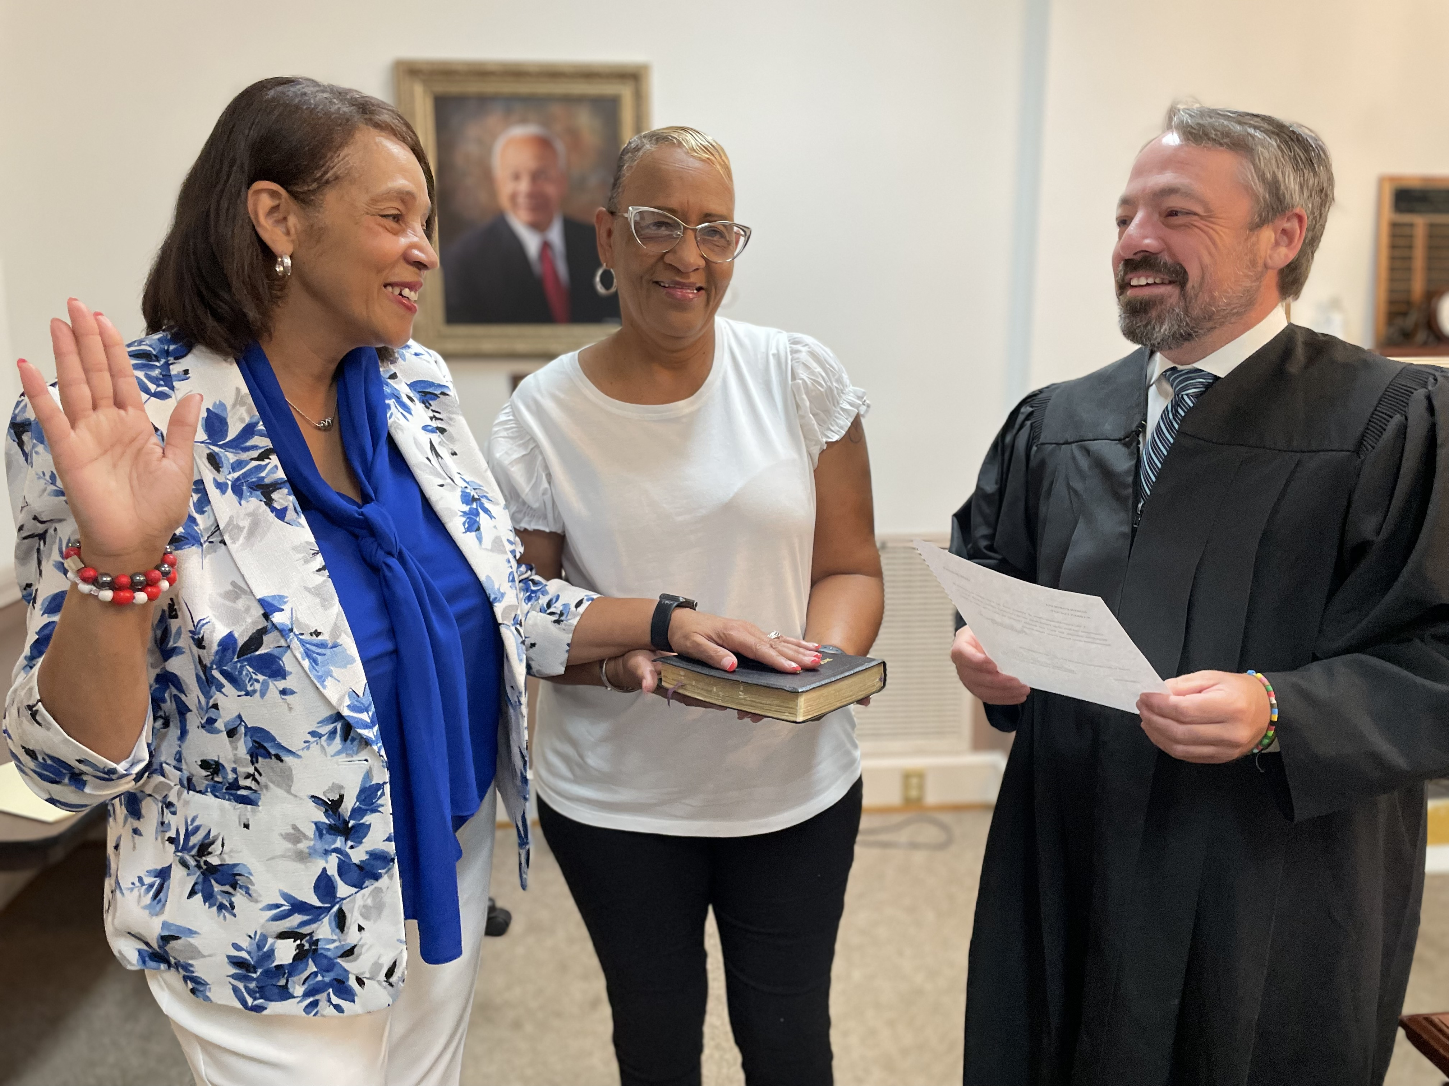
First 30 Days
Phase 1
Transition
CHAMPIONS
for Children
4|
with kindness!

Slide 5
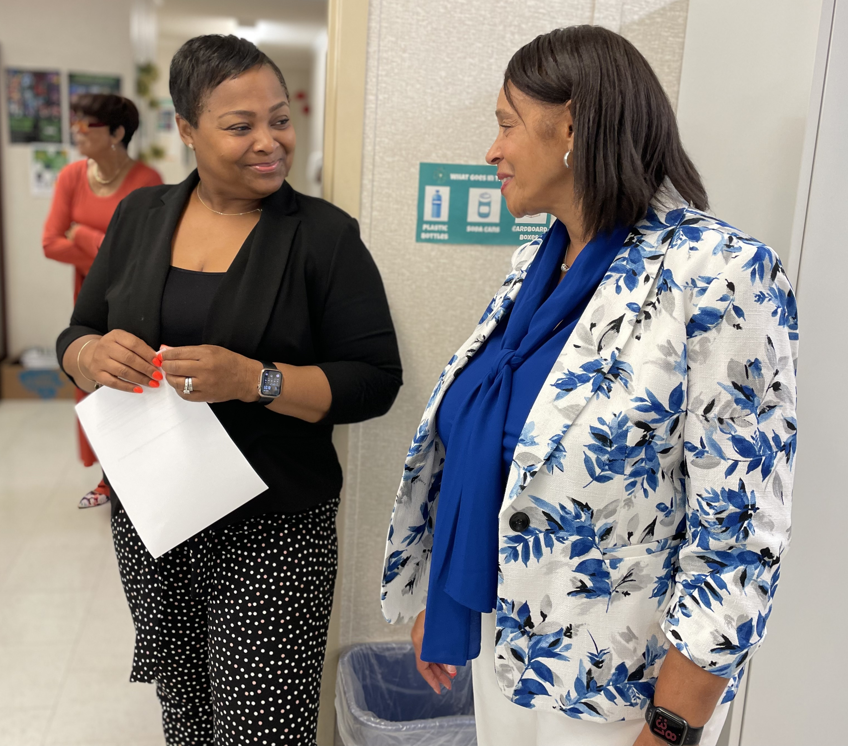
First 30 Days:
Observing and Listening
Focus areas and action taken
Listen to all stakeholder groups
Met with every department
Met individually with every principal, cabinet member, and director
Visited every school and interacted with students and staff
Joined Juvenile Crime Prevention Council (JCPC) and Economic Development Board
Identify strengths and growth areas
Analyzed EVAAS data with school and district administrators
Modeled expected behaviors for principals and central services administrators
Establish collaborative planning frameworks
Tweaked the format of Principals’ meetings to improve efficiency
Expanded senior cabinet to include technology
CHAMPIONS
for Children
5|
with kindness!

Slide 6
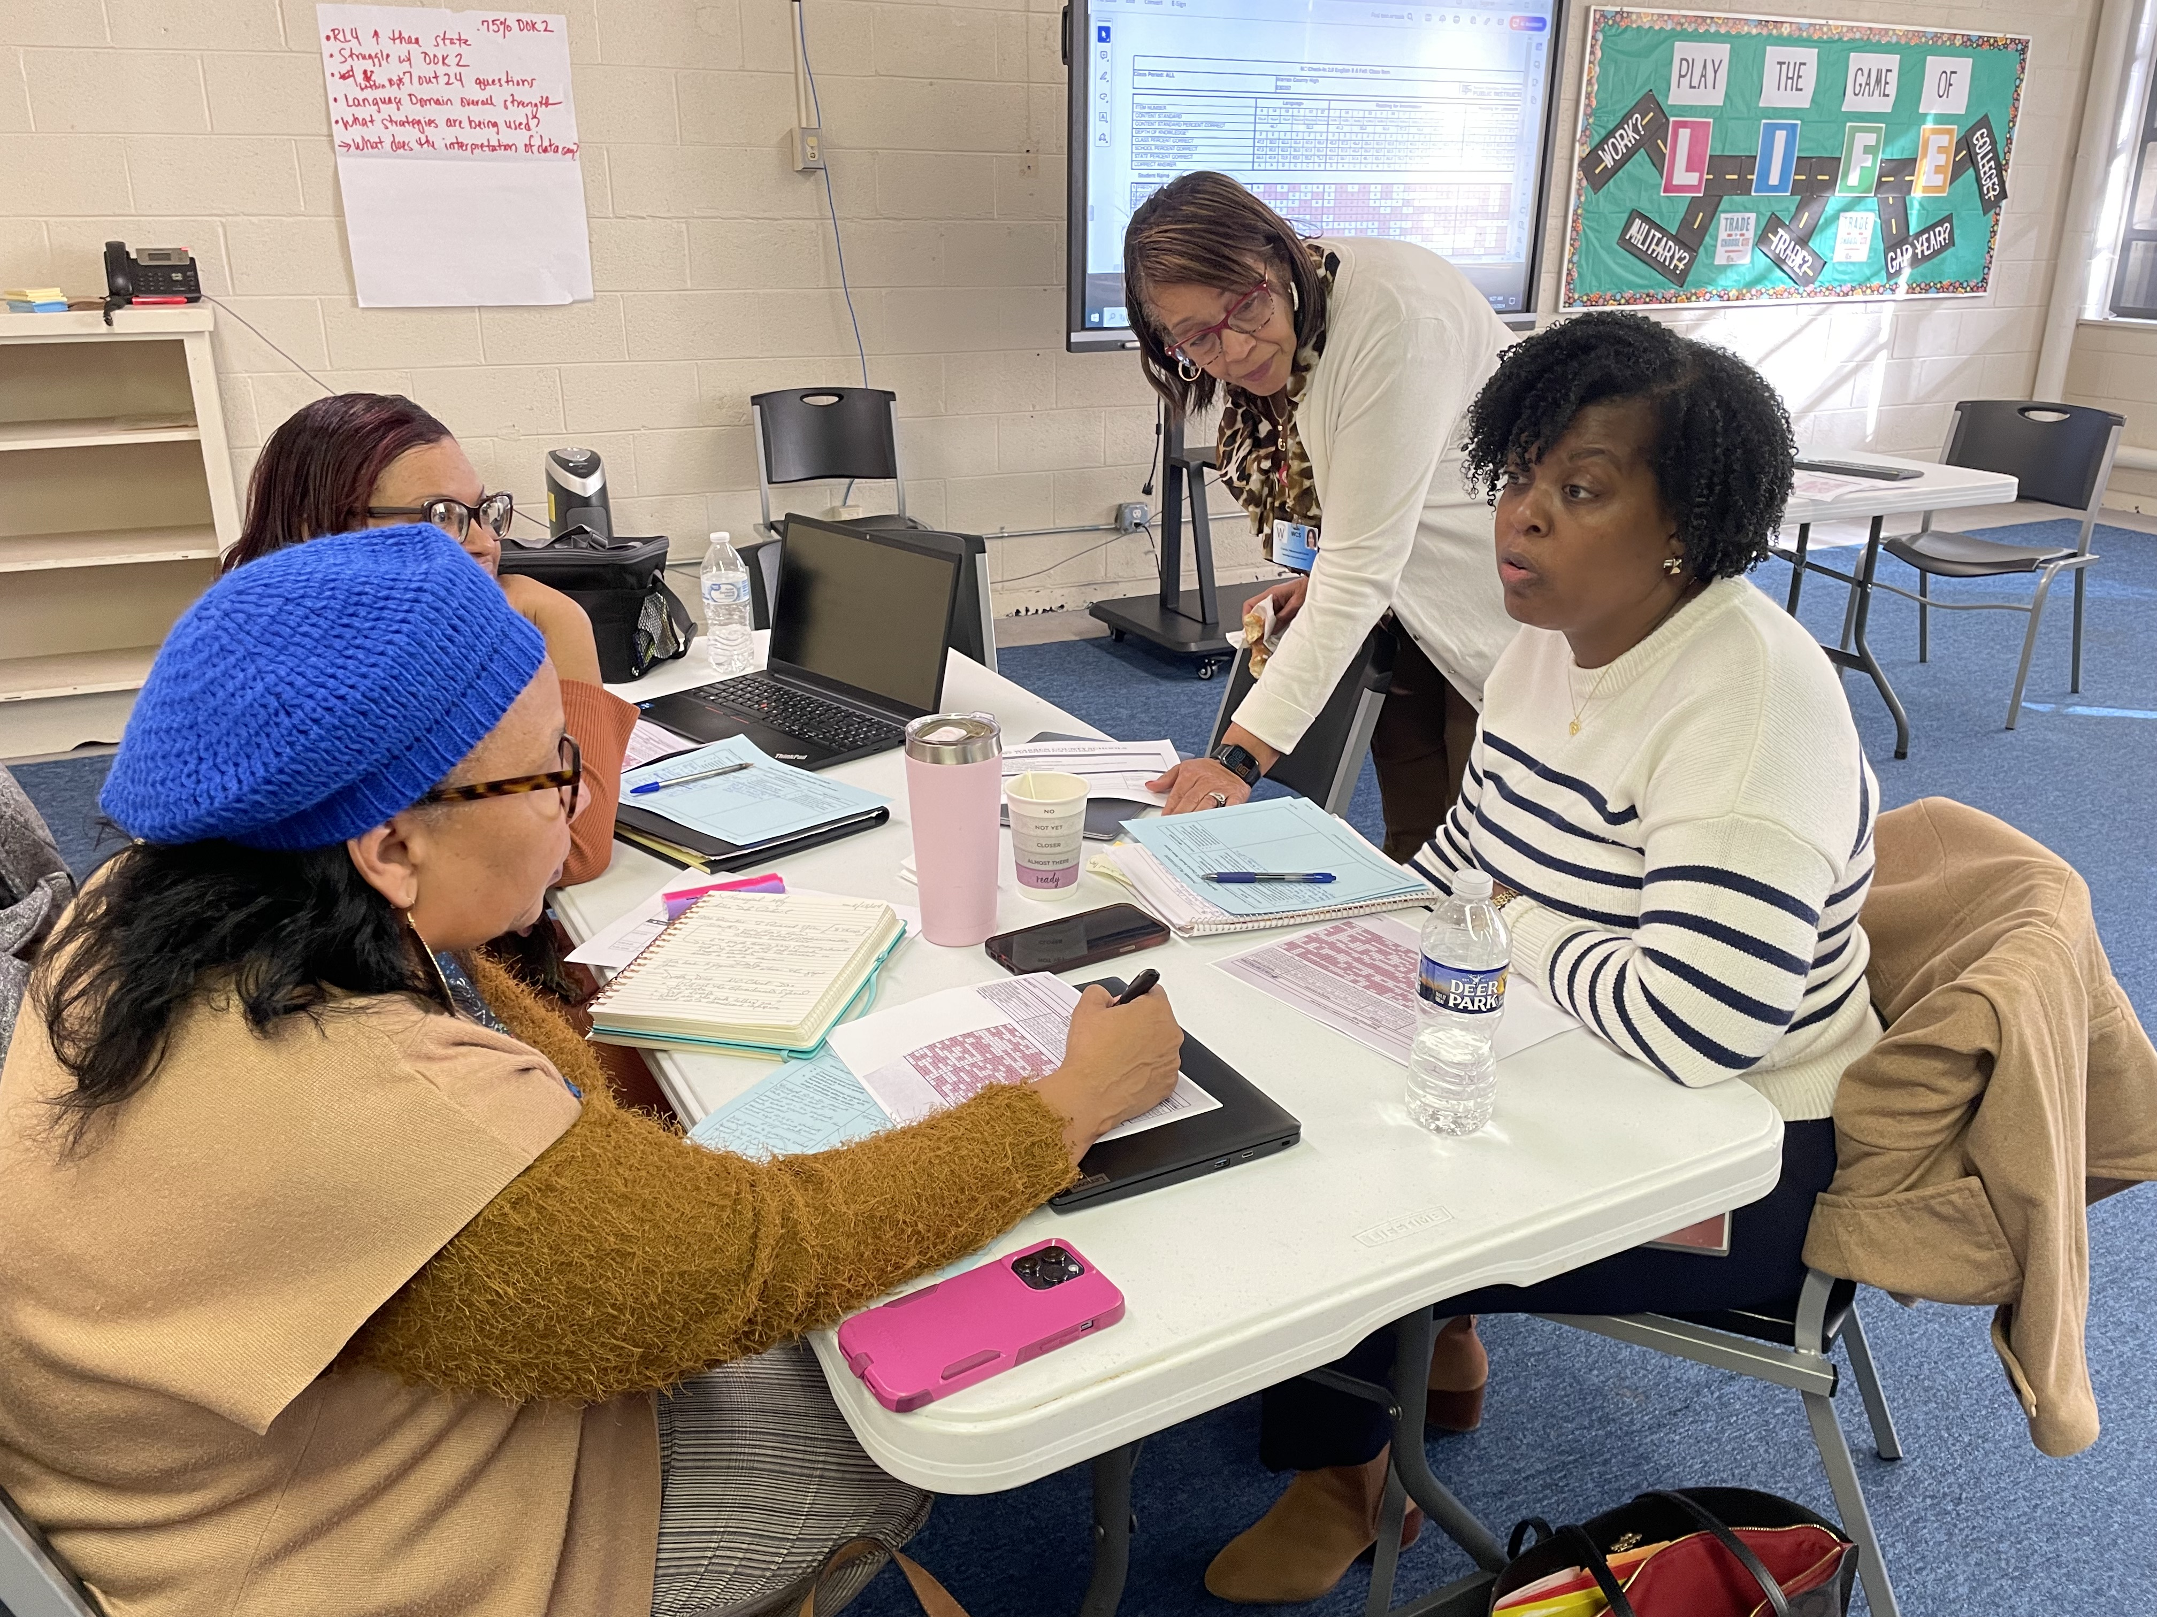
60 Days
Phase 2
Transition
CHAMPIONS
for Children
6|
with kindness!

Slide 7
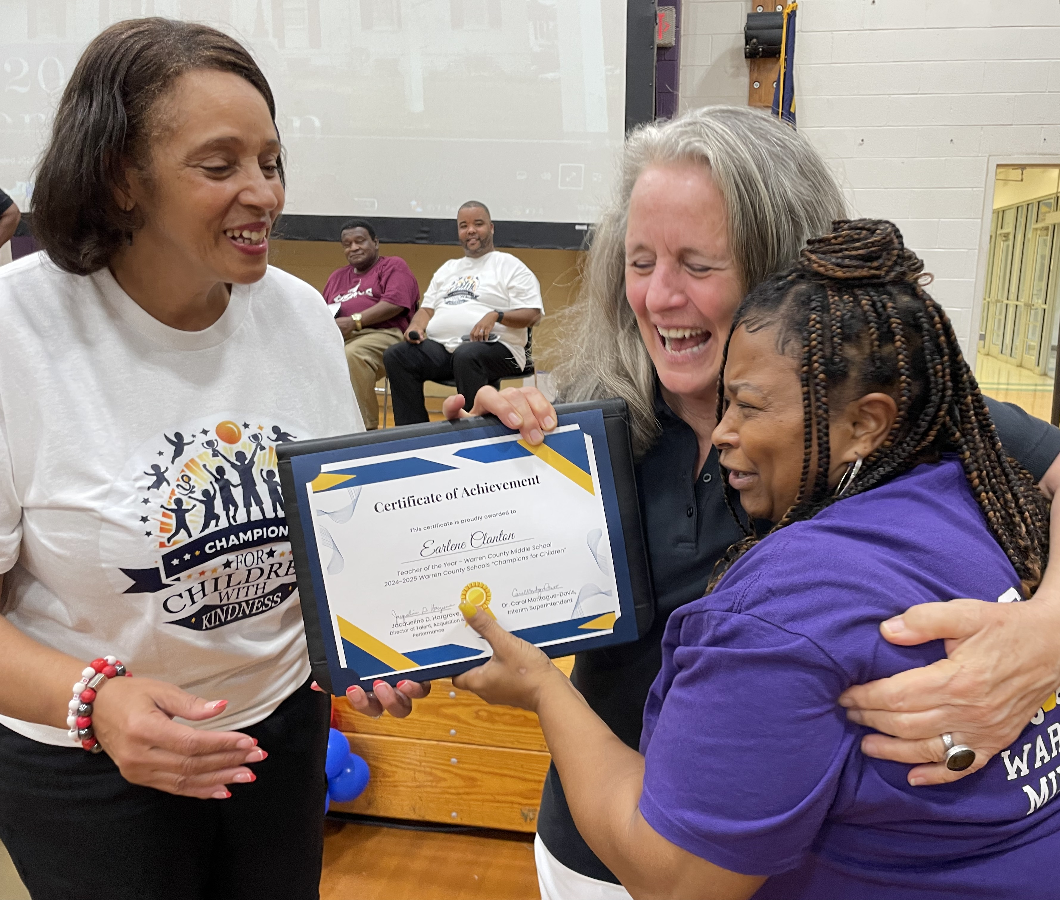
First 60 Days:
Building Relationships
Focus areas and action taken
Model data-driven administration
Organized deep data dives for Principals’ PLCs
(Professional Learning Community meetings)
Analyzed NC Check-in and EVAAS data to identify trends and needs
and help principals with how to provide intentional feedback
Facilitated community engagement sessions
In-person and online
Attended local events and meetings
Recognize staff contributions and improve morale
Teacher of the Year, Beginning Teacher of the Year, Principal of the Year
Recognize department accomplishments and
individual staff awards
CHAMPIONS
for Children
7|
with kindness!

Slide 8
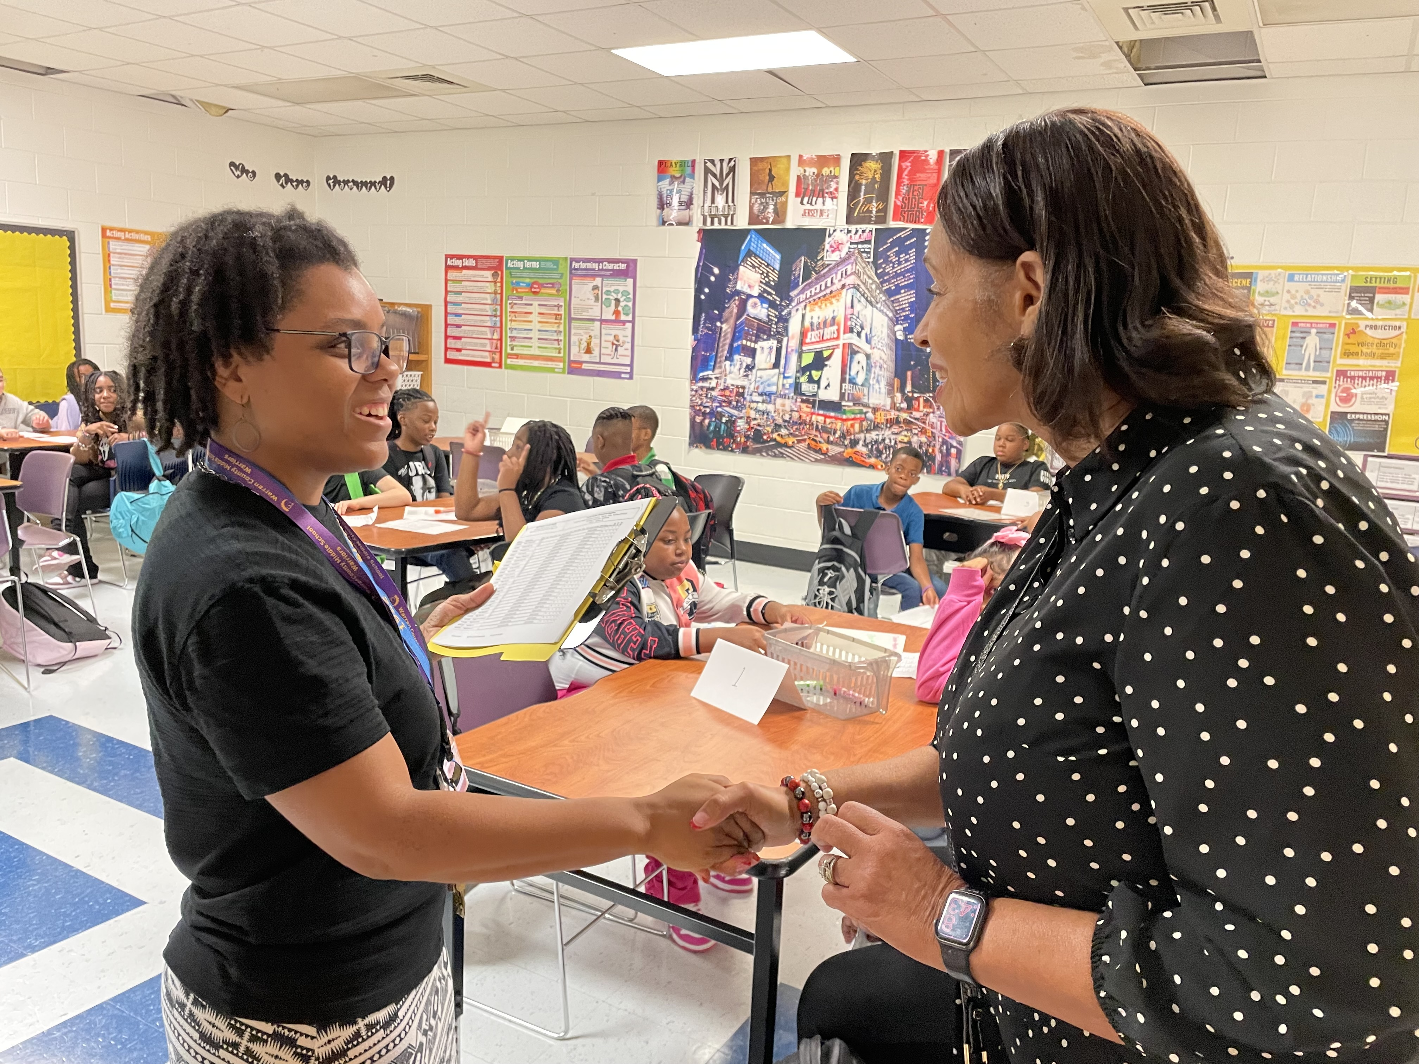
90 Days
Phase 3
Transition
CHAMPIONS
for Children
8|
with kindness!

Slide 9
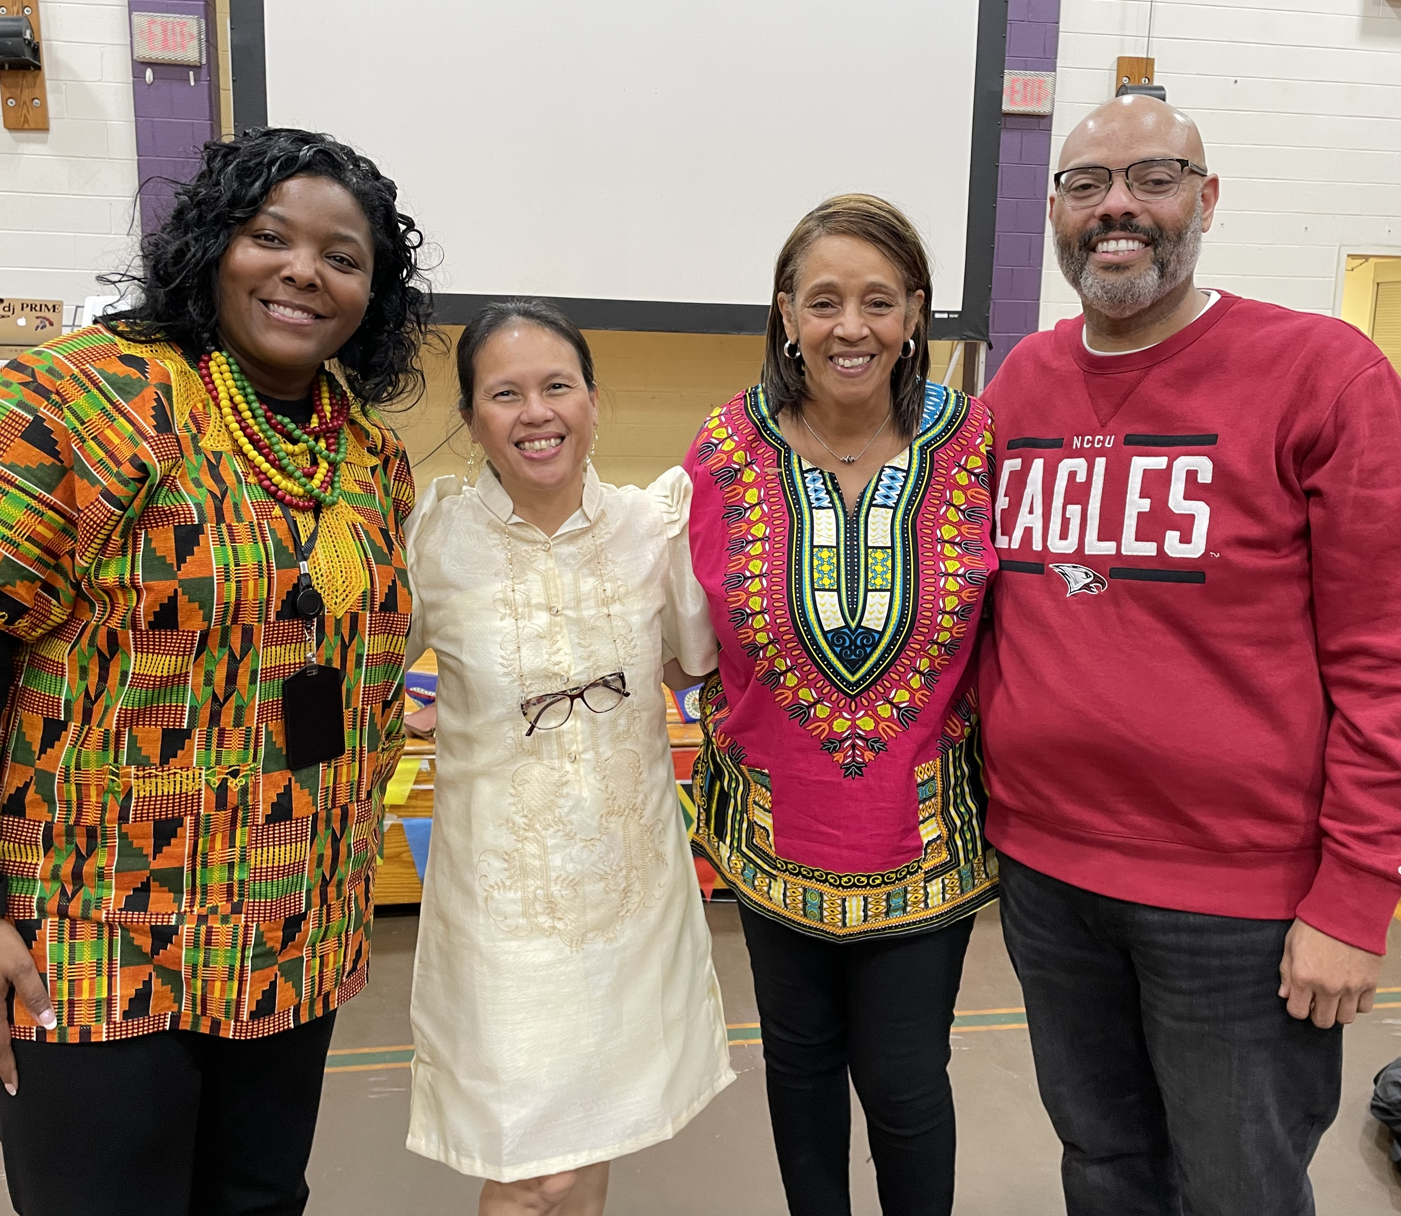
First 90 Days:
Planning and Implementing
Focus areas and action taken
Launched equity-focused professional development
Ensure meaningful and intentional training to build
staff capacity
Delivered strategic planning framework for district goals
Collaboratively reviewed, analyzed, and tweaked the district’s strategic goals
Enhance operational efficiency through resource audits
Line-item review of district and school budgets
Initiated facility maintenance and improvement projects
  Middle school roof
  WCHS press box and concession stand
  Two new activity buses
CHAMPIONS
for Children
9|
with kindness!

Slide 10
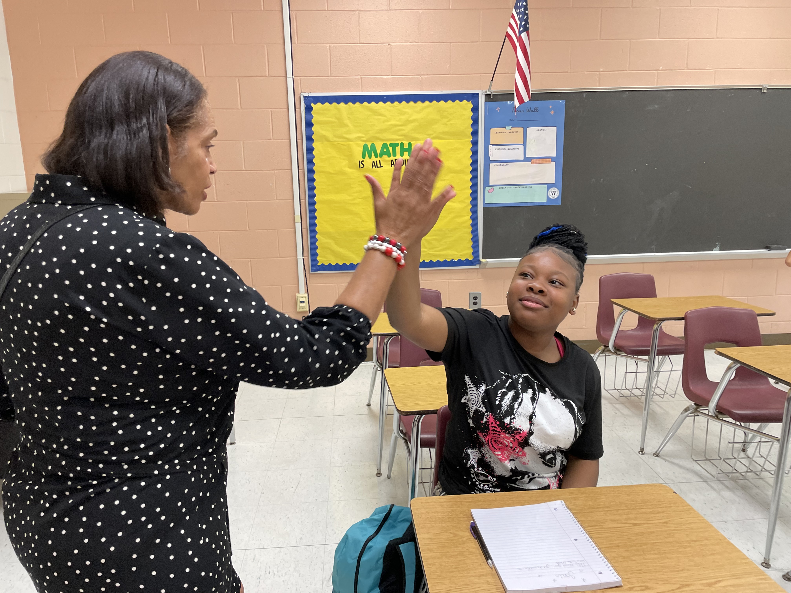
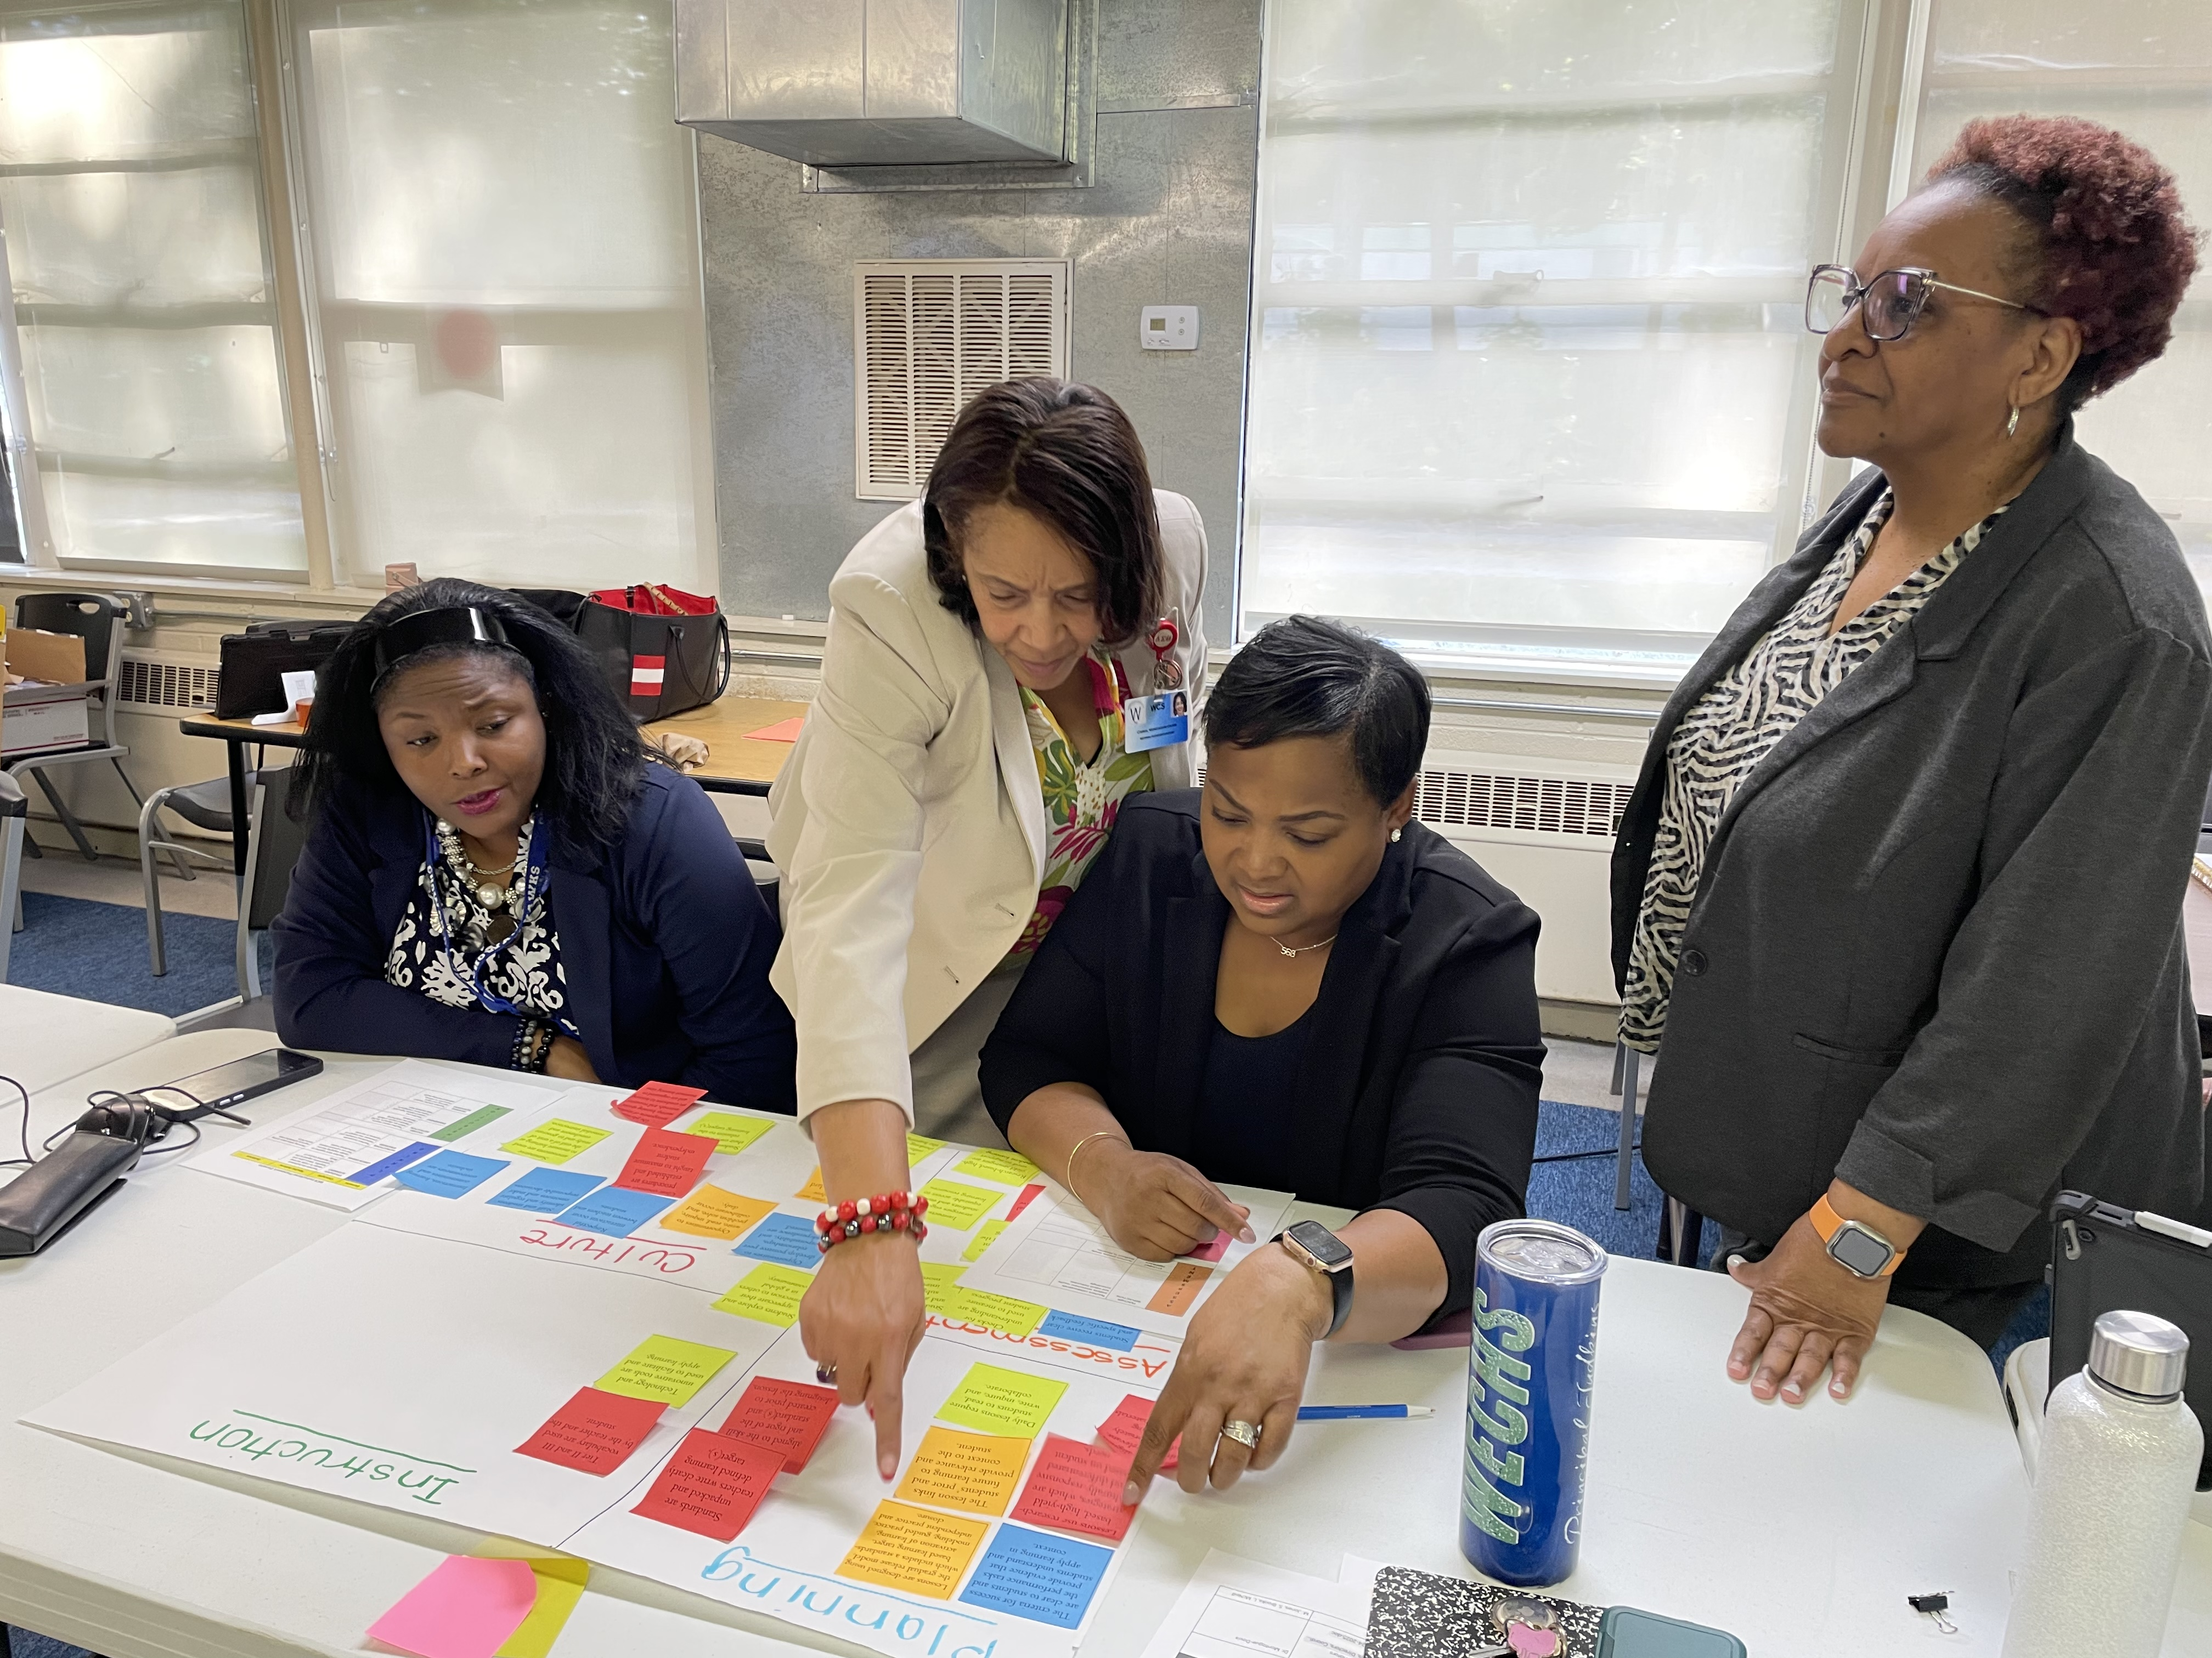
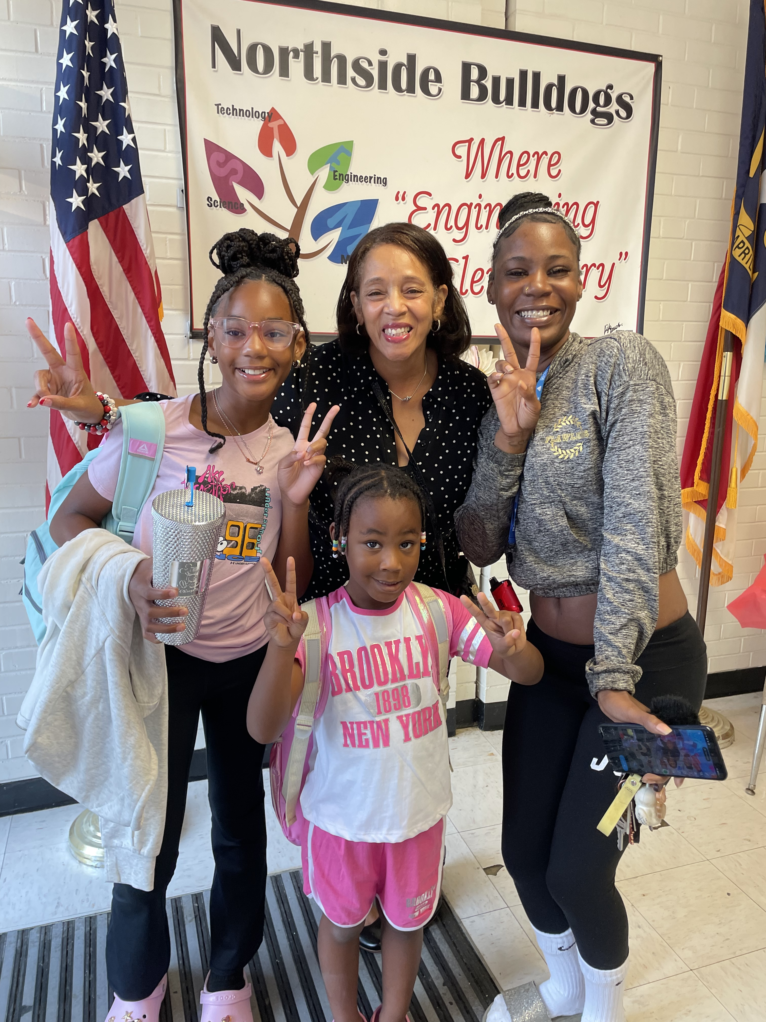
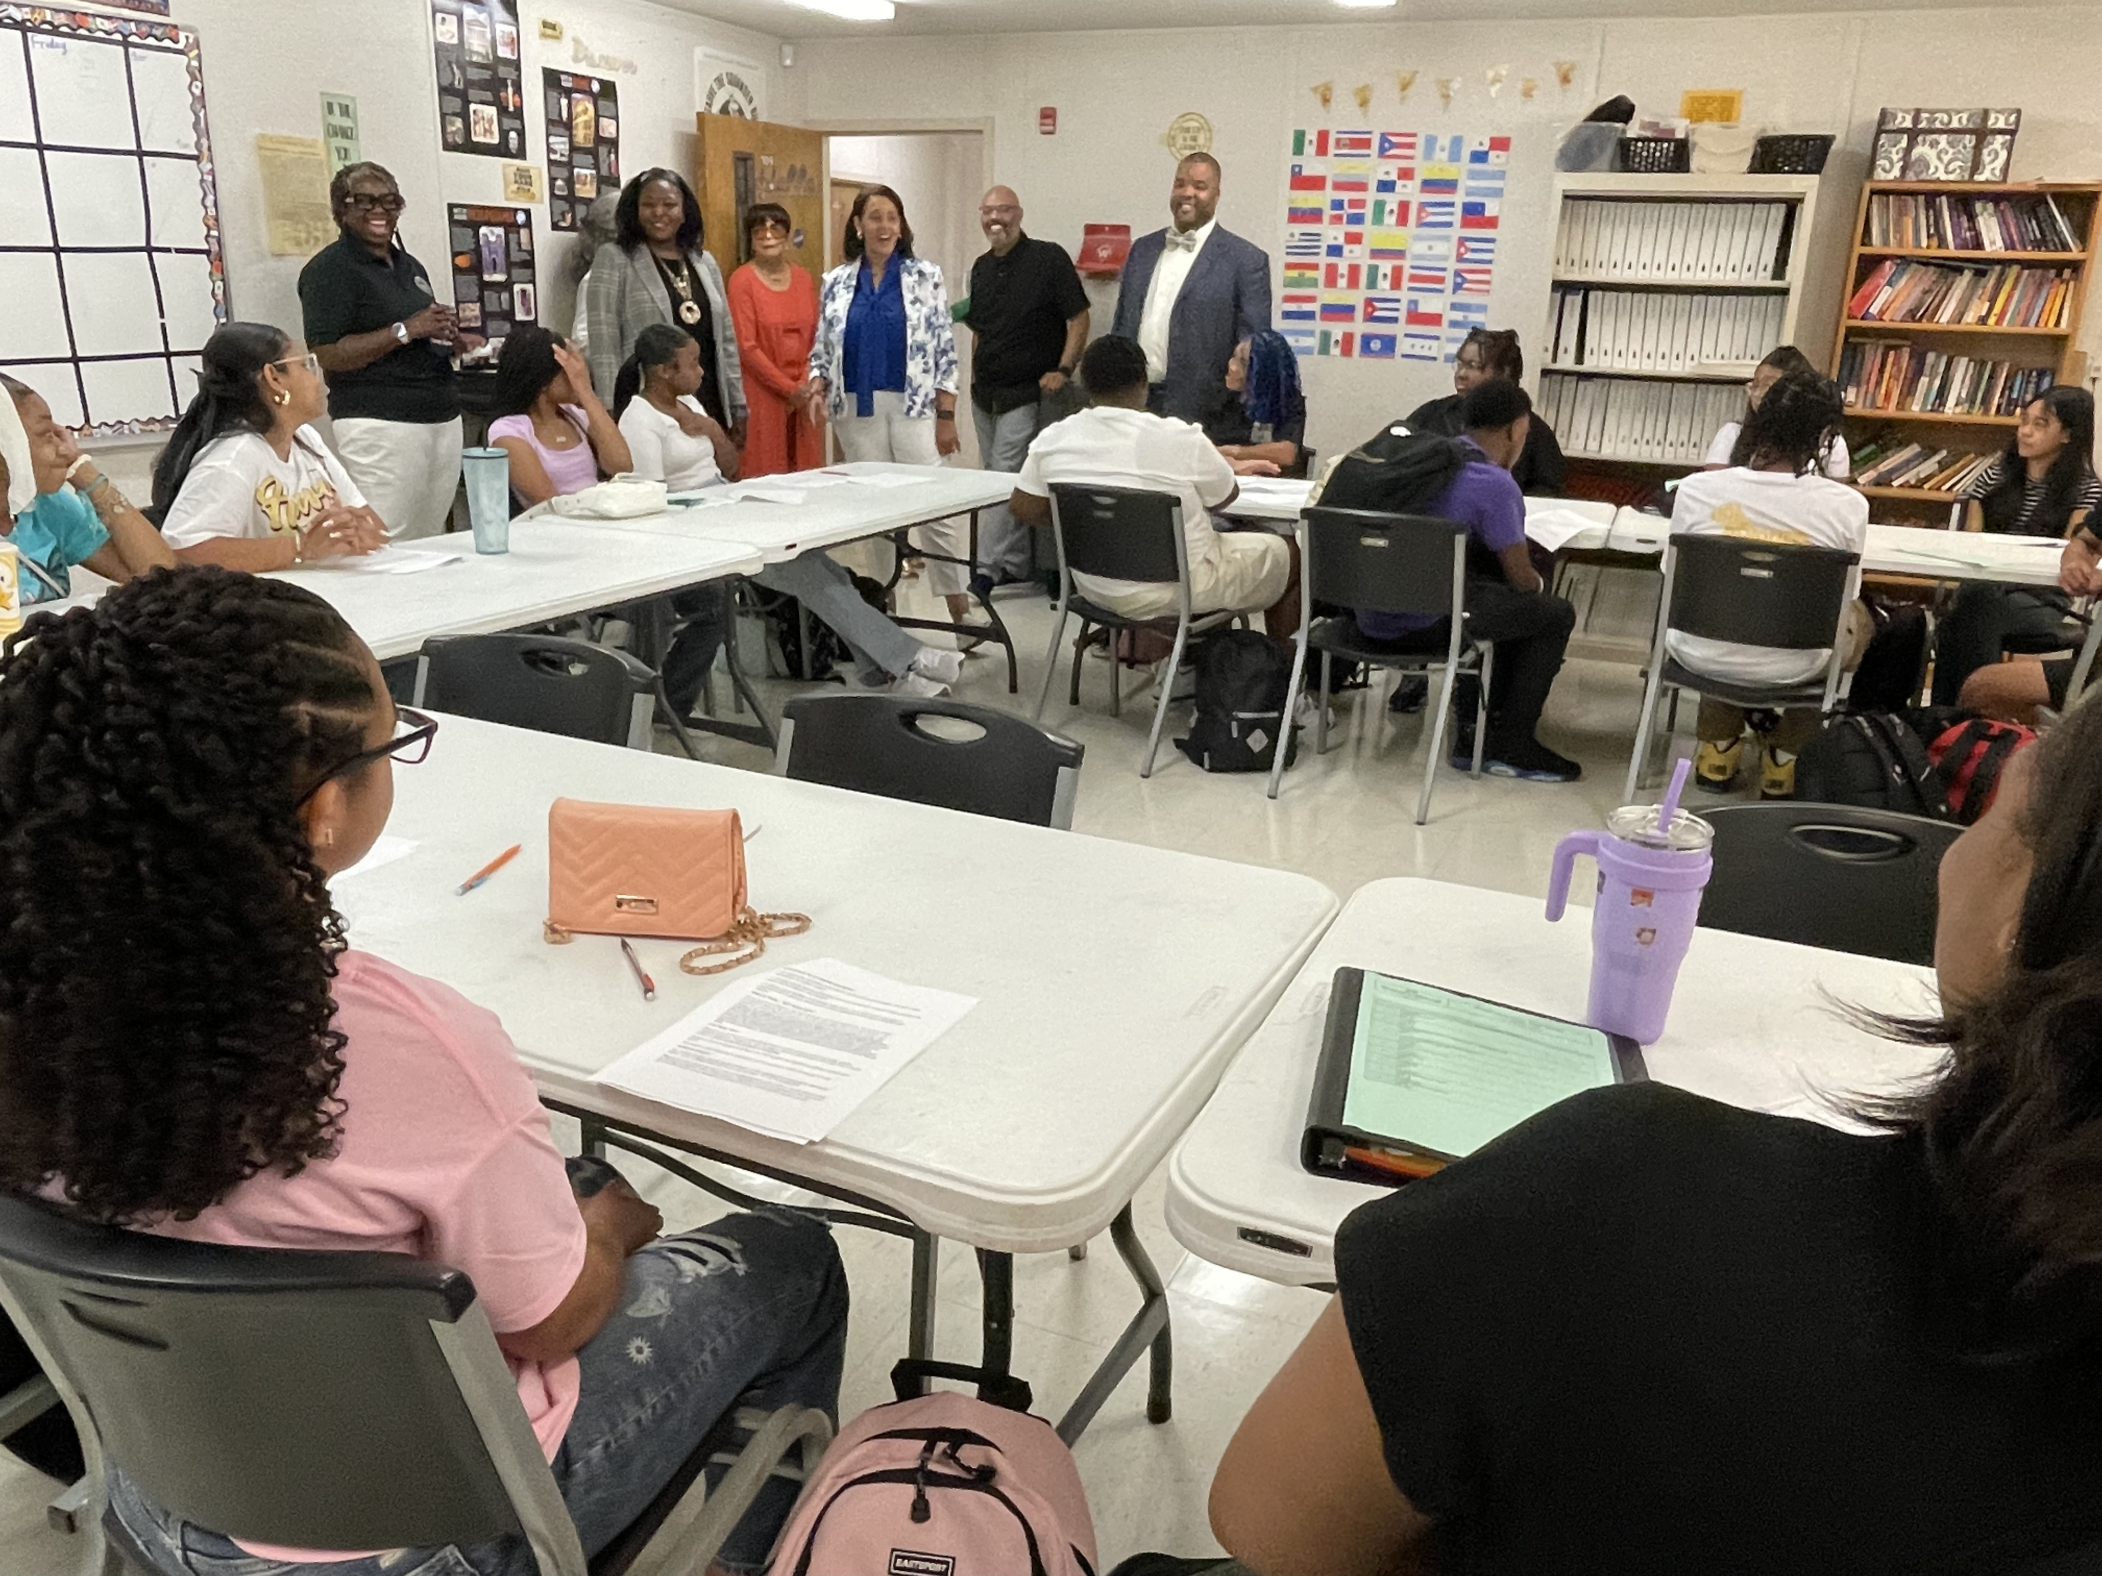

District Goals by June 2025
Increase student proficiency across core subjects
Develop principal coaching capacity
Improve family and community engagement
Teachers implement district- aligned strategies
Increase retention of hard-to-staff positions
CHAMPIONS
for Children
10|
with kindness!

Slide 11
90-Days Key Metrics of Success
Goal 1: Increase Student Proficiency
Targeted interventions for underperforming subgroups led to a 15% increase in participation by December 2024.
Improved standards-aligned practices, reducing performance gaps in key cohorts (e.g., 4th-to-5th grade Reading, 6th-to-7th grade Math).
CHAMPIONS
for Children
11|
with kindness!

Slide 12
90-Days Key Metrics of Success
Goal 2: Train and Empower >80% of Teachers
Delivered professional development to 50% of teachers by December 2024, focusing on equity and instructional strategies.
Established district-wide coaching frameworks and monthly data meetings to refine teaching practices.
CHAMPIONS
for Children
12|
with kindness!

Slide 13
90-Days Key Metrics of Success
Goal 3: Build Leadership Capacity
Engaged 100% of principals in coaching cycles, strengthening instructional leadership.
Modeled data-driven strategies in Principal PLCs to address Instructional gaps.
CHAMPIONS
for Children
13|
with kindness!

Slide 14
90-Days Key Metrics of Success
Goal 4: Increase Retention in Hard- to-Staff Positions
Recruitment strategies boosted applicant interest by 20% for Math, Science, and EC positions.
Launched onboarding programs to support new hires and improve retention.
CHAMPIONS
for Children
14|
with kindness!

Slide 15



Key Outcomes
As of December 2024
Principals engaged in
coaching cycles
Teachers trained in district-aligned strategies
Increased student participation in interventions
Expanded applicant pool for hard-to-staff roles

Slide 16



Key Approach
Emphasized the Use of Data
to Drive Improvement
Leveraged ATLAS Protocol in Principal PLCs
Used NC Check-In data to
identify instructional gaps
Focused on targeted interventions for subgroups (Black, EL, SWD)
Embedded monthly data reviews to adjust strategies

Slide 17













Next Steps
1
2
3
4
Update and begin implementing the district's strategic plan
Expand professional development to enhance instructional practices
Strengthen partnerships with families and community stakeholders
Monitor and adjust strategies to meet performance goals

Slide 18
Questions?
CHAMPIONS
for Children
18|
with kindness!

