Slide 1

Operations Update
Board of Education Meeting
August 27, 2024
Dr. Carol Montague-Davis
Interim Superintendent
Dr. Dennis Carrington
Chief Operations Officer
RC Creech
Transportation Director
Diana Muema
Child Nutrition Director
VJ Hunt
WCHS Athletic Director
CHAMPIONS
for Children
with kindness!

Slide 2
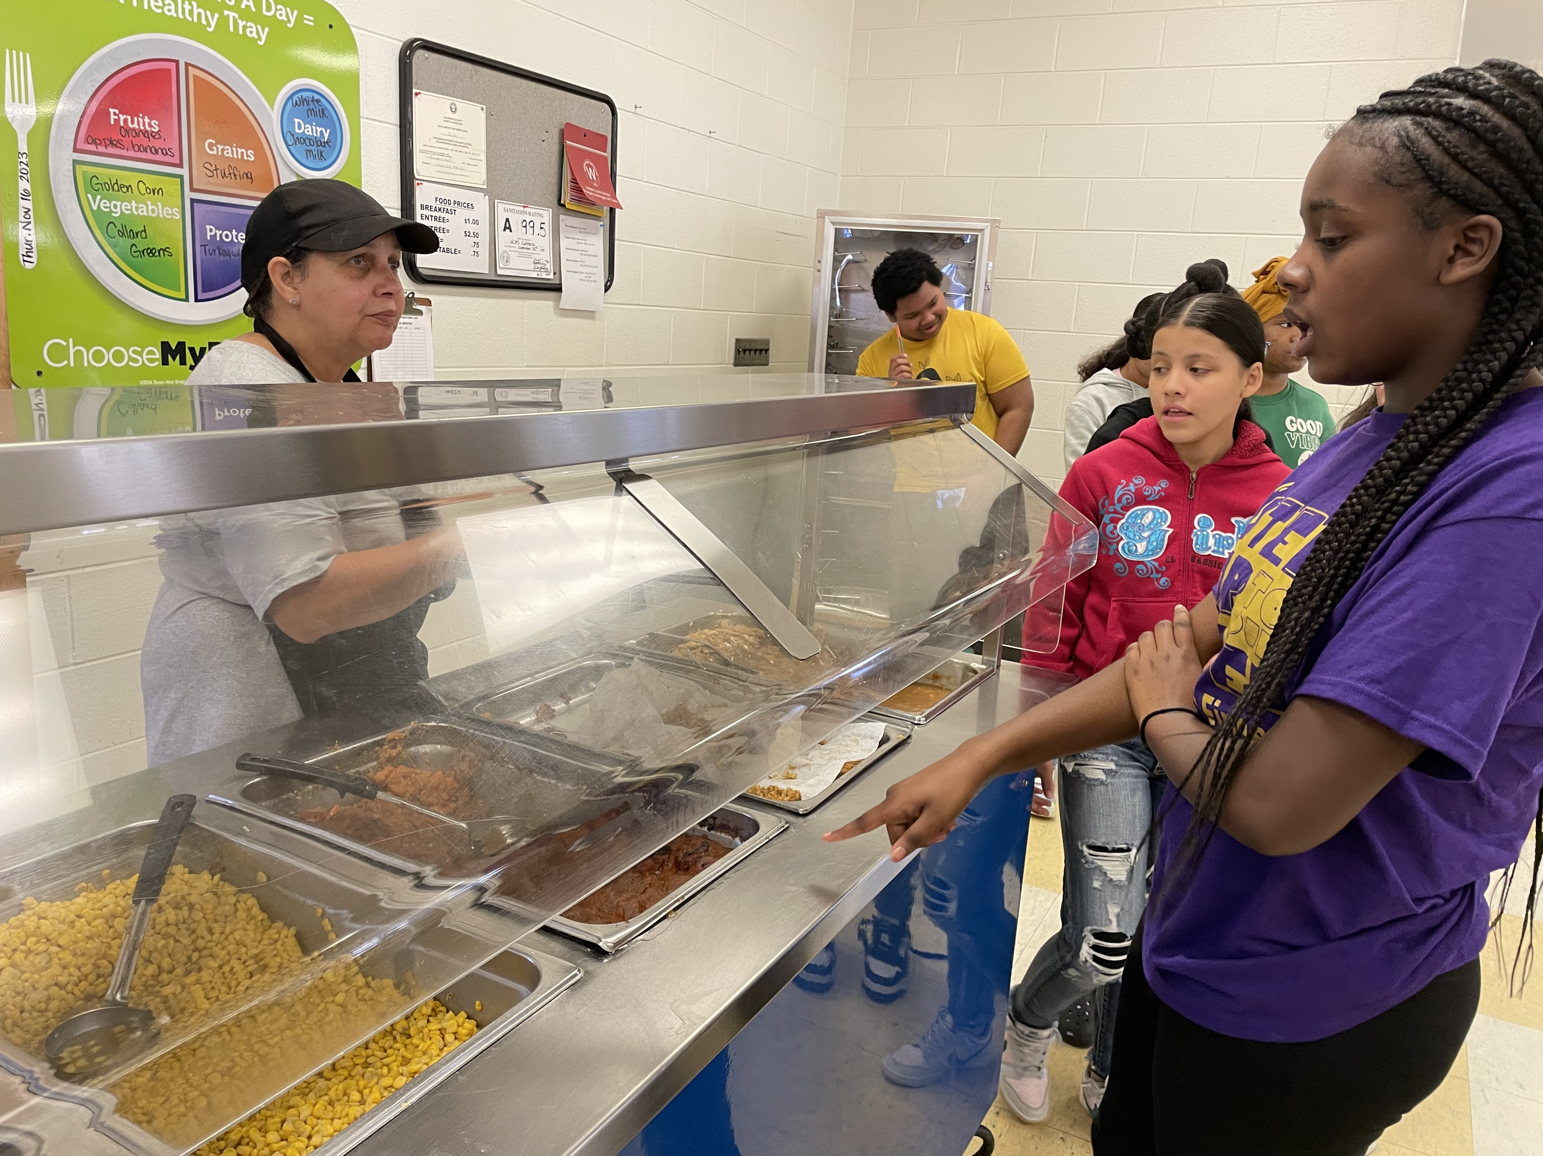
Operations Updates
Enrollment
Transportation
Child Nutrition
Athletics
CHAMPIONS
for Children
2|
with kindness!

Slide 3
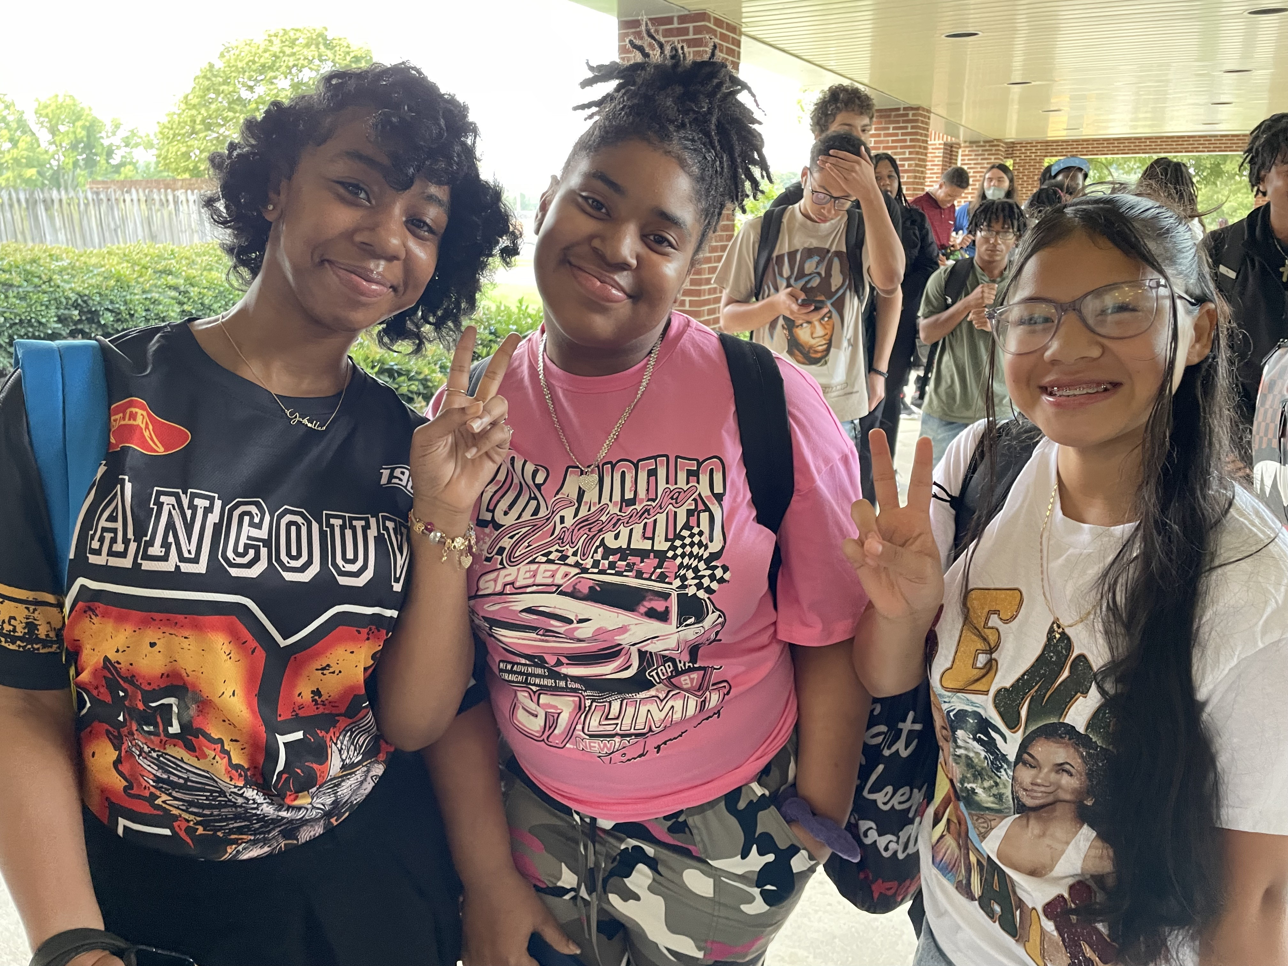
FY 2024-2025 Enrollment Updates
WCHS
  331 attended on first day
  335 students as of 08/26/2024
WECHS
  117 attended on first day
  117 students as of 08/26/2024
WCMS
  341 attended on first day (8/26/24)
  371 enrolled
CHAMPIONS
for Children
3|
with kindness!

Slide 4
Elementary school enrollments as of 8/26/2024
Grade | MBES | NES | VES | Grade Totals
PK | 10 | 13 | 0 | 23
K | 36 | 34 | 23 | 93
1 | 50 | 44 | 28 | 122
2 | 49 | 43 | 28 | 120
3 | 52 | 51 | 21 | 124
4 | 56 | 35 | 26 | 117
5 | 43 | 48 | 22 | 113
TOTAL | 296 | 268 | 148 | 712
CHAMPIONS
for Children
4|
with kindness!

Slide 5
Transportation
Fully staffed with bus drivers for our 33 buses serving PreK-12
Upgraded transportation parking lot lights to LED, which are brighter and more cost-efficient to operate
Switched our parts vendor for bus filters to save money and solve supply issues
Resumed Federal Motor Carrier Safety Association (FMCSA) random drug testing, which was halted during Covid
CHAMPIONS
for Children
5|
with kindness!

Slide 6
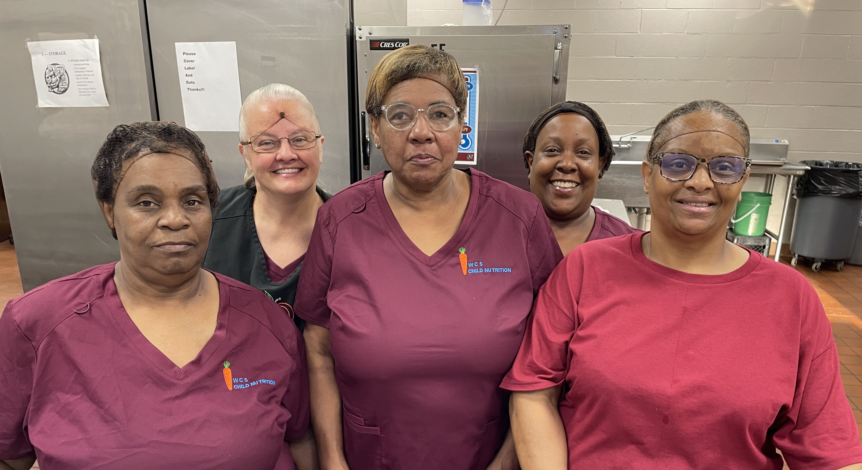
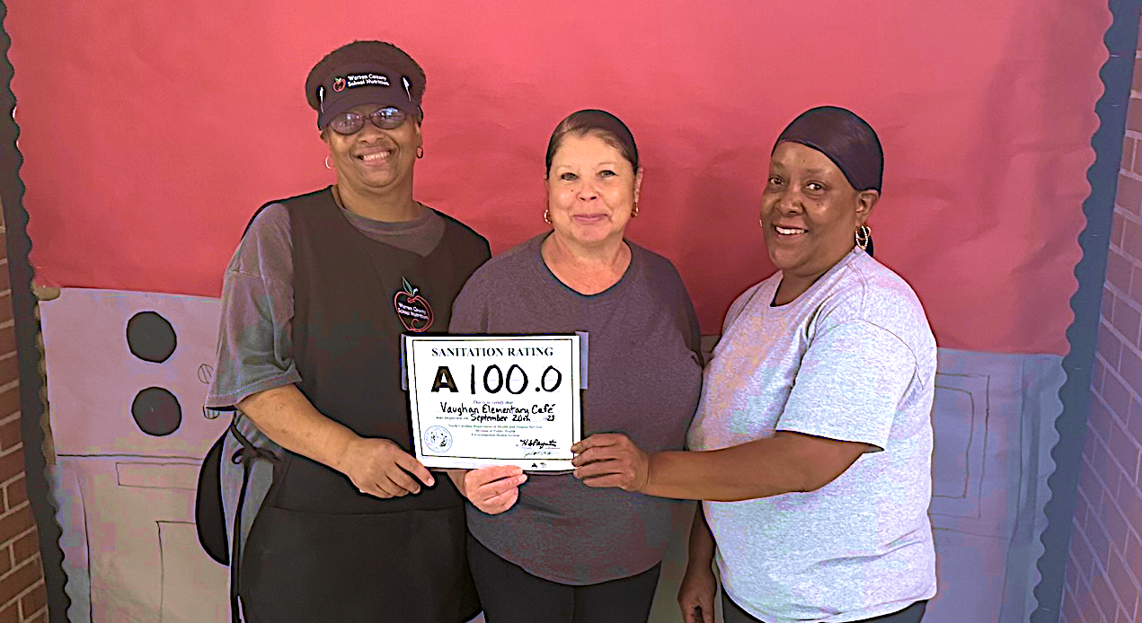
Child Nutrition Department
Touring local farms to establish partnerships for Farm to School of NC
Preparing for a September ServSafe class and test for all employees to earn safe food handling certification
Preparing for annual review in April
CHAMPIONS
for Children
6|
with kindness!

Slide 7
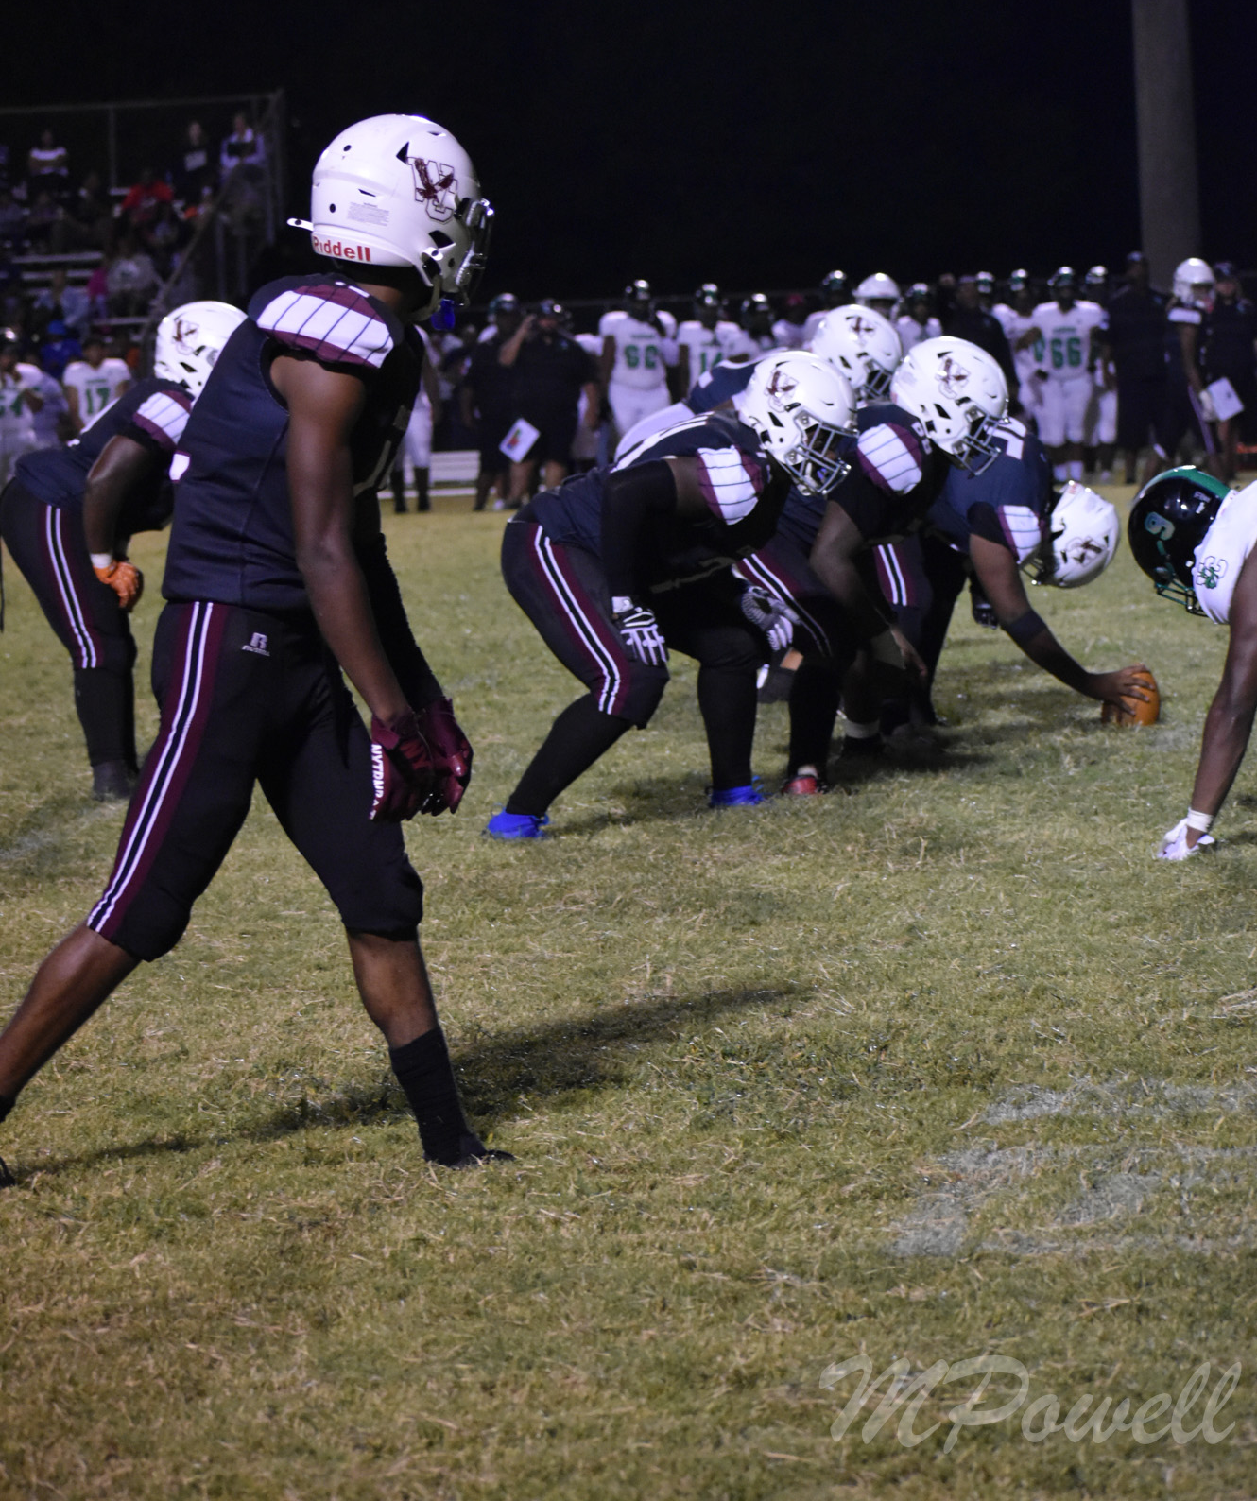
Athletics
Fall participation numbers
Field preparation robot
Next games
  Today: WCHS Volleyball vs. North Edgecombe at 4:30
  Thursday: WCHS Volleyball vs. Southeast Collegiate Prep Academy at 4:30
  Friday: WCMS Volleyball at Enfield Middle at 4:30
  Friday: WCHS Football vs. J.F. Webb at 7:00
CHAMPIONS
for Children
7|
with kindness!

Slide 8
Questions?
CHAMPIONS
for Children
8|
with kindness!

