Slide 1

Warren County Schools
FY 2025-2026
Dr. Carol Montague-Davis
Interim Superintendent
Superintendent’s Budget Proposal
Board of Education Meeting
April 8, 2025
CHAMPIONS
for Children
with kindness!

Slide 2
Agenda
Superintendent’s Proposed Budget Priorities
Proposed Local Operating Budget Requests
Proposed Capital Operating Budget Requests
FY 2025-2026 Proposed
Budget Summary
CHAMPIONS
for Children
with kindness!

Slide 3

FY 2025-2026 Superintendent's Proposed Budget Priorities
Staffing
Staff Recruitment and Retention
Organizational Changes and Enhancements
Technology Sustainability
Integrating sustainability principles into the technology lifecycle
Focusing on energy efficiency, responsible hardware and software management, and minimizing waste
‹#›|

Slide 4
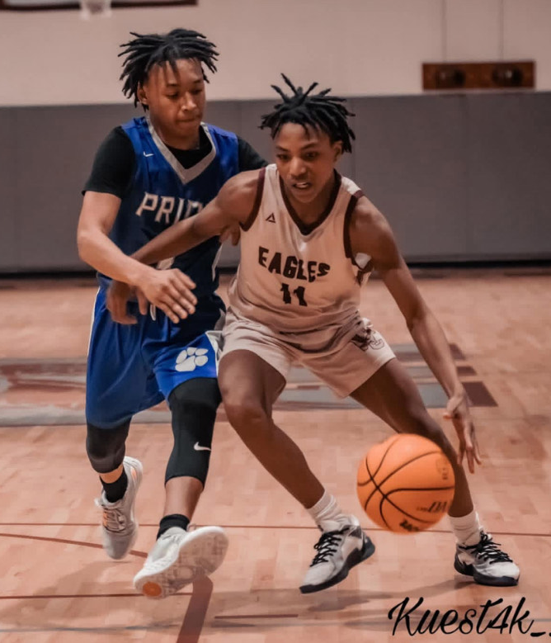
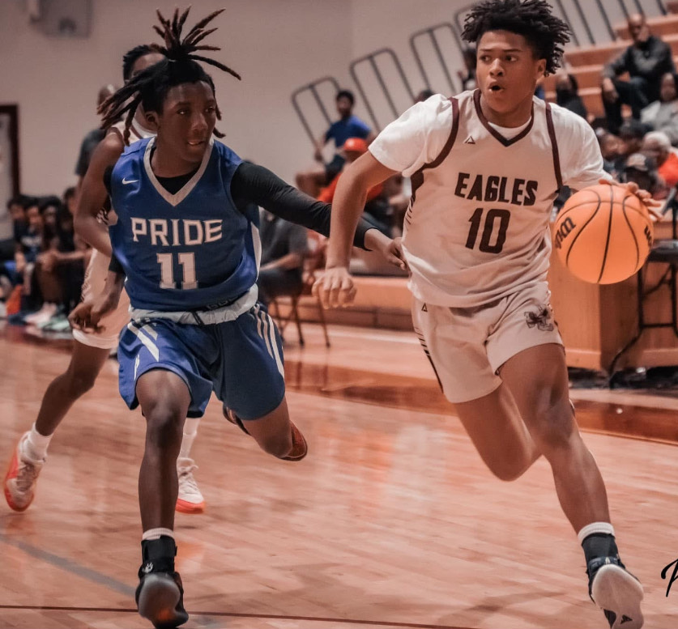
FY 2025-2026 Superintendent’s Proposed Budget Priorities
Enhancement of Athletics
Update Facilities
Reconditioning Equipment
Security and Officials
Future Investments
Facilities
Transportation
Next Phase Developments
‹#›|

Slide 5
County Appropriation History
Fiscal Year | Local | Capital Outlay | Total
2020-2021 | $4,784,331 | $350,000 | $5,134,331
2021-2022 | $5,034,331 | $350,000 | $5,384,331
2022-2023 | $5,034,331 | $350,000 | $5,384,331
2023-2024 | $5,384,331 | $350,000 | $5,734,331
2024-2025 | $5,384,331 | $350,000 | $5,734,331
‹#›|

Slide 6
FY 2025-2026 Proposed Supplement Increase
WCS Employee Supplement Increases
 | 2019-20 School Year | 2020-21 School Year | 2025-2026 School Year
Teachers | $1,900 | $2,900 | $3,500
Classified Staff | $300 | $600 | $1,200
Retention Factors: Average Regional Local Supplements
Northampton County: Halifax County: Franklin County Vance County: Roanoke Rapids: Granville County: | $3,333 $3,700 $3,969 $5,348 $5,630 $5,916
Source: NC Association of County Commissioners, 2023 Selected Statistics of Local Salary Supplements
‹#›|

Slide 7
FY 2025-2026 Proposed Local Operating Budget Request
Increase Teacher Supplements
 | Current | Requested
Supplement Amount | $2,900 | $3,500
Yearly Cost | $478,500 | $577,500
Total Cost Including Benefits | $630,136 | $760,509
Increase Classified Employees
 | Current | Requested
Supplement Amount | $600 | $1,200
Yearly Cost | $55,800 | $111,600
Total Cost Including Benefits | $74,000 | $148,000

Slide 8

FY 2025-2026 Proposed Capital Operating Budget Request
Activity Bus |Recurring payment for activity buses = $62,000
WCHS Chiller | Removing heat from a liquid coolant in refrigeration = $132,000
WCHS Gym Floor | Upgrading the gym floor as a safety measure for our athletes = $190,000
WCMS Fields |Fixing softball field = $60,000
WCMS Gym | Expanding the gym floor = $50,000
Total for Capital Operating Request = $508,000
‹#›|

Slide 9
Budget Pressures and Mandated Increases
Utility Cost
Increase
2022 = $539,827
2023 = $543,548
2024 = $590,926
Insurance Costs
Increase
2022 = $53,687
2023 = $57,405
2024 = $148,055
Funding Sent to
17 Charter Schools
2024 = $1,330,000
2025 = $1,185,000
year to date
State Funds for Exceptional Children (EC)
State funds EC for up to 13% of ADM
Warren County Schools at 17.4% in April 2024 not funding 71 EC students – value of $239,397 from district
‹#›|

Slide 10
FY 2025 -2026 Proposed
Budget Summary
Category | FY 25 Current | FY 26 Proposed | Increase
Local | $5,384,331 | $5,858,381 | $474,000
Capital | $350,000 | $508,000 | $158,000
Current Expense Expansion | $180,000 | $180,000 | 0
SEMAA | $119,000 | $119,000 | 0
Total | $6,033,331 | $6,665,381 | $632,000
‹#›|

Slide 11
Questions?
CHAMPIONS
for Children
‹#›|
with kindness!

