Slide 1

Human Resources Updates
Board of Education Meeting
August 27, 2024
Dr. Carol Montague-Davis
Interim Superintendent
Dr. Keedra Whitaker
Chief Human Resources Officer
Ms. Jacqueline Hargrove
Director of Talent Acquisition and Performance
CHAMPIONS
for Children
with kindness!

Slide 2
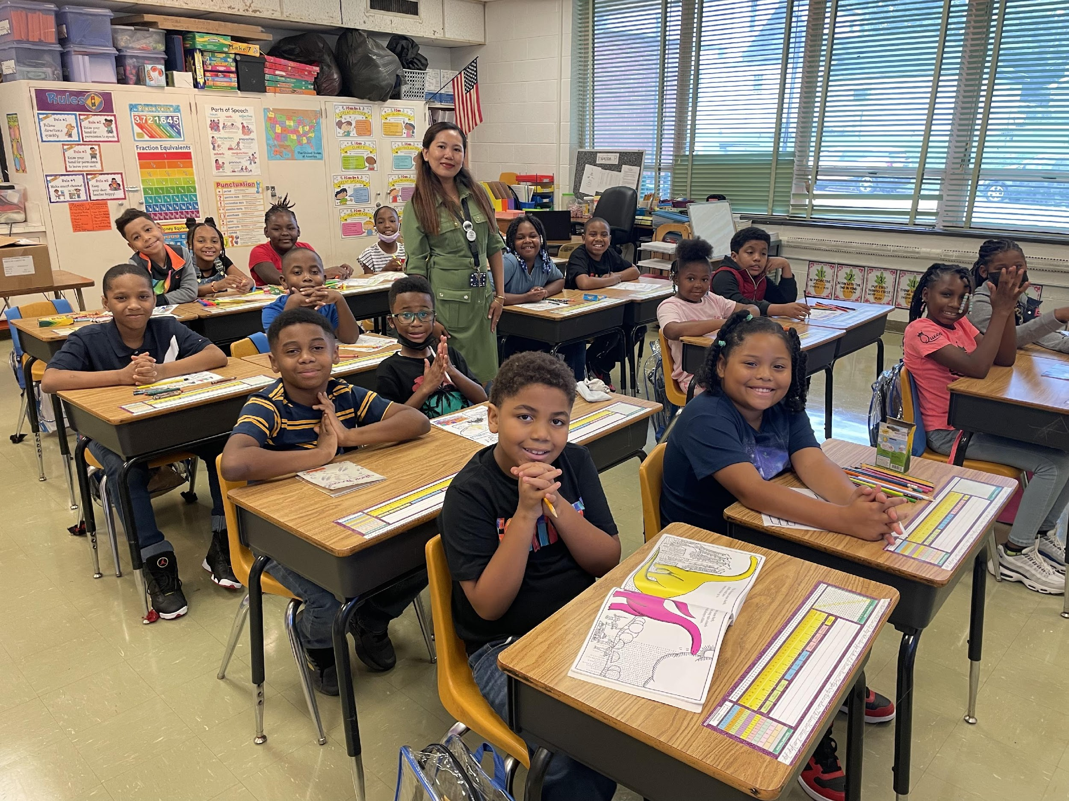
WCMS Staff Stipend due to Calendar Adjustment
Administration recommendation:
Overview: Warren County Middle School staff that reported to work during the week of August 5th-9th will receive a stipend.
Stipend Amounts are as follow: $100.00 per day for classified staff and $125.00 per day for certified staff. The purpose of this stipend per administration, is to compensate employees for the time they worked which was prior to the recent calendar change, and to maintain labor law compliance. It will be issued by the September end of month payroll.
CHAMPIONS
for Children
with kindness!
‹#›|

Slide 3
Vacancy Updates by School
Mariam Boyd
2 Elementary Teachers (K and 5th)
1 EC Teacher (CC)
1 Art Teacher
1 Music Teacher (shared)
Vaughan
2 Elementary Teachers (K and 2nd)
1 PE Teacher
1 Music Teacher (shared)
Northside
2 Elementary Teachers (K and 3rd)
1 School Counselor
WCMS
1 Math Teacher
1 AIG Teacher
1 EC Teacher Assistant
WCHS
1 (OCS) Teacher
1 EC Teacher (SC)
1 EC Teacher (Resource, shared)
1 School Counselor
1 CTE Teacher (Health Science Ed.)
1 Air Force ROTC Instructor
SparkLab Leader
WECHS
1 EC Teacher (Resource, shared)
CHAMPIONS
for Children
‹#›|
with kindness!

Slide 4
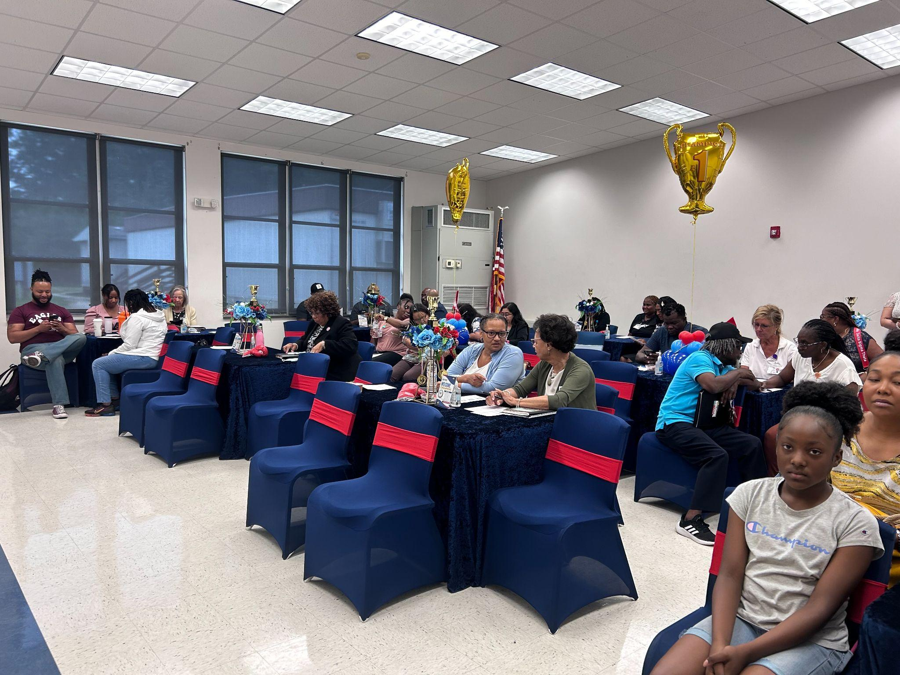
New Employee/Beginning Teacher Orientation
New Employee Orientation:
Took place July 30th, 31st and August 2nd 2024.
26 New Employees attended (Inclusive of teachers, administrators and support staff)
Included professional development and information sessions.
Last day of event wrapped up with a Tour of Warren County.
CHAMPIONS
for Children
‹#›|
with kindness!

Slide 5


New Employee/Beginning Teacher Orientation (continued)
New Employee/Beginning Teacher Orientation:
Special Thanks
WCS Board, Faulty, Staff, and
Community Stakeholders
Talya Somerville, Phased by the Moon
WCS Child Food Nutrition Department:
Breakfast (July 30, 2024)
KimmieDees: Lunch (July 30-31, 2024)
Warren County’s Gamma Chi Chapter of Delta Kappa Gamma:
Breakfast (July 31, 2024)
Heritage Quilters and WCS:
Breakfast and County Tour
All Central Services Departments
CHAMPIONS
for Children
‹#›|
with kindness!

Slide 6
Questions?
CHAMPIONS
for Children
‹#›|
with kindness!

