Slide 1

Operations Updates
Board of Education Meeting
January 14, 2025
Dr. Carol Montague-Davis
Interim Superintendent
Dr. Dennis Carrington
Chief Operations Officer
CHAMPIONS
for Children
with kindness!

Slide 2
Operations Updates
Smart Pouch Updates
CHAMPIONS
for Children
2|
with kindness!

Slide 3
Smart Pouches
Our Smart Pouch initiative was launched on Monday, January 6, 2024 at Warren County Middle School, Warren Early College High School, and Warren County High School.
CHAMPIONS
for Children
3|
with kindness!

Slide 4
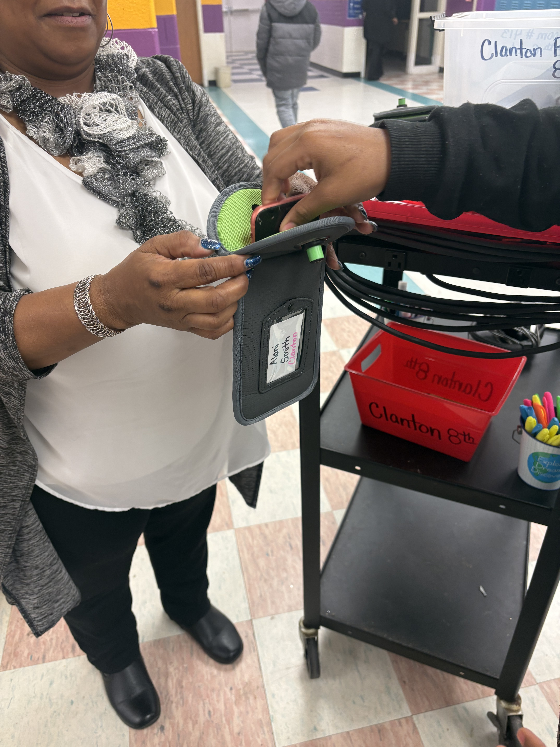
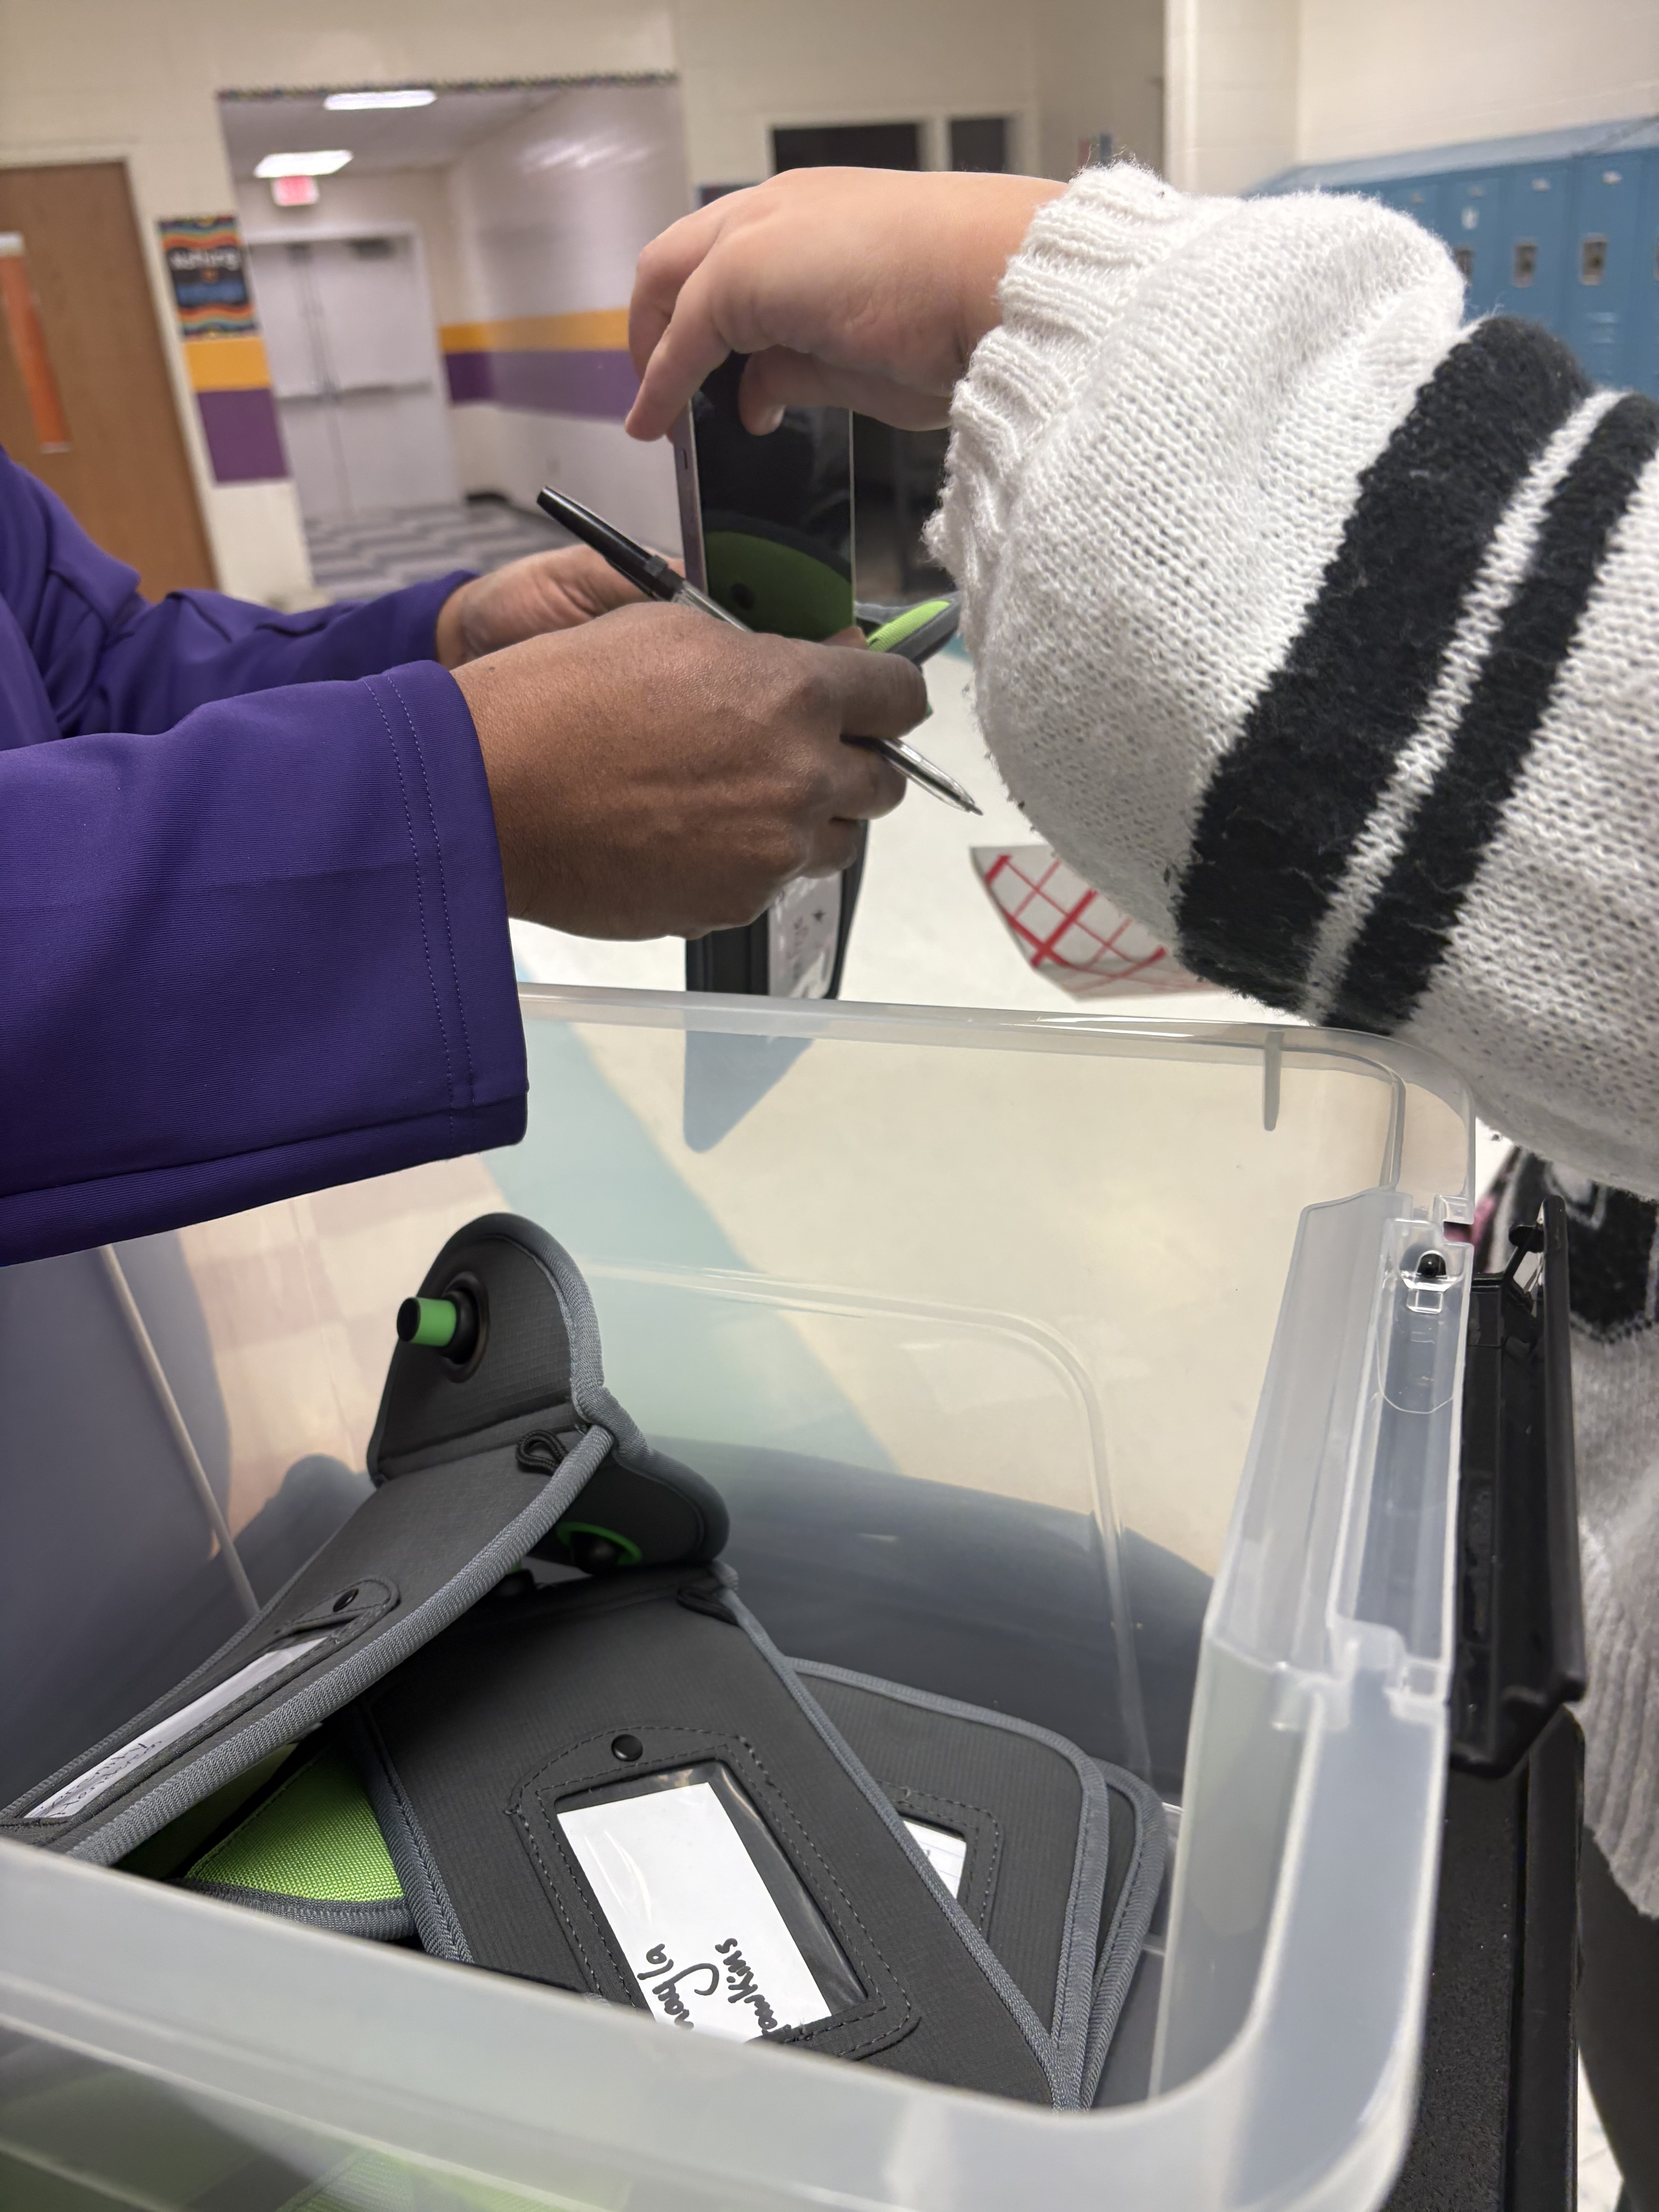
Process in Action!!
CHAMPIONS
for Children
4|
with kindness!

Slide 5
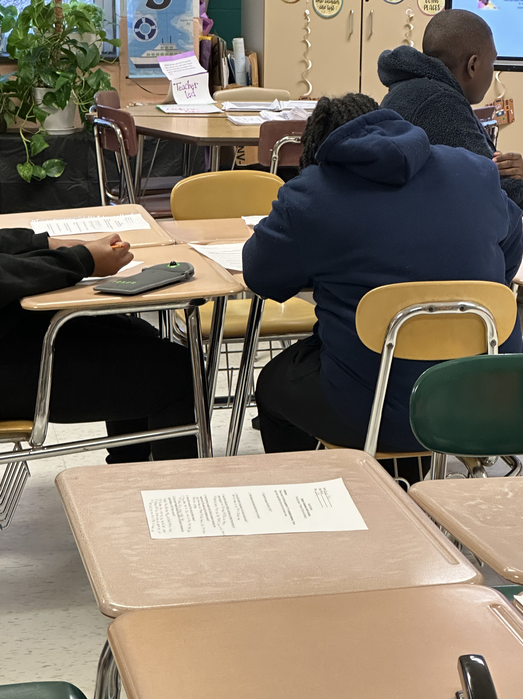
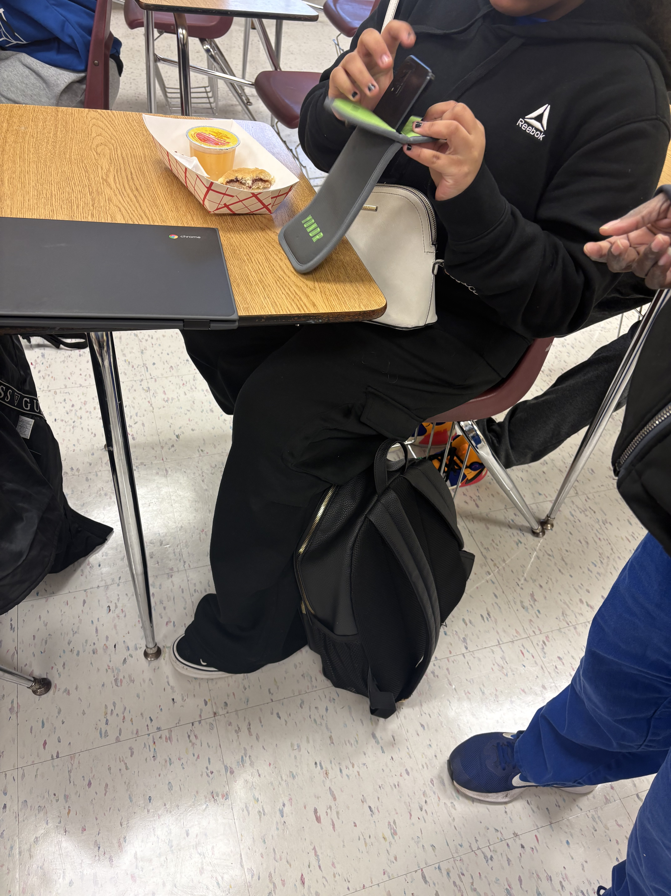
CHAMPIONS
for Children
5|
with kindness!

Slide 6
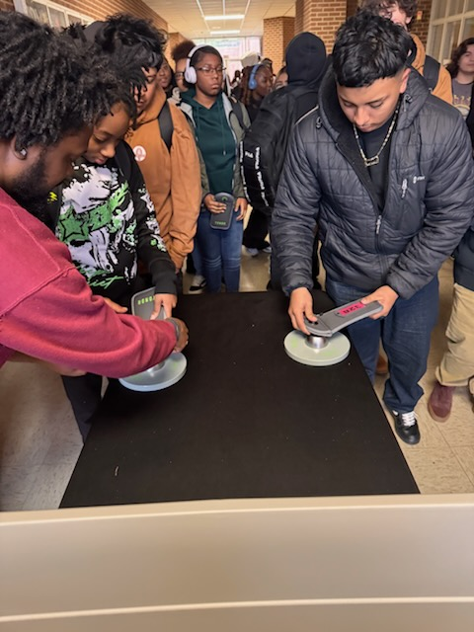
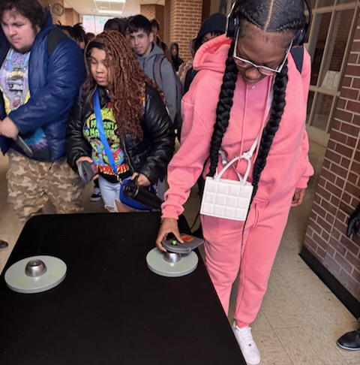
CHAMPIONS
for Children
6|
with kindness!

Slide 7
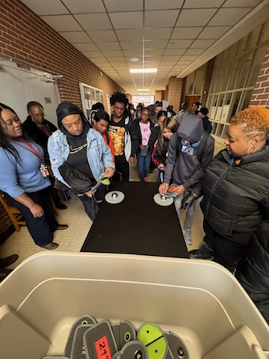
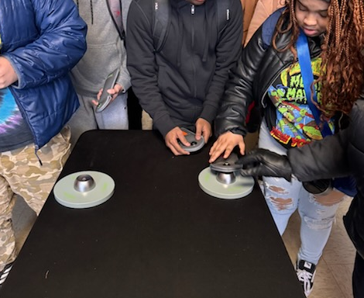
CHAMPIONS
for Children
7|
with kindness!

Slide 8
What are our students saying about the Smart Pouch initiative?
“ They are helping us learn better!” (Middle School student)
“With the phone pouch, I don’t even think about my phone as much, I am able to concentrate on what the teacher is teaching!” (Middle School student)
“All the students are working and more focused!” (HS student)
“Seeing more students being productive!” (HS student)
“I don’t really use my phone, but the class is really different now!” (HS student)
CHAMPIONS
for Children
8|
with kindness!

Slide 9
What are our students saying about the Smart Pouch initiative?
“With the use of the Yondr pouches so far, I have experienced a greater level of focus in my schoolwork. I have found myself able to do more work during my college labs than before. Before the pouches, I was scrolling through my phone the entire class period when I could have been utilizing the time to do homework or catch up on classwork. Now that I can use that time wisely and not be distracted by my phone, I find myself having more time during the weekend to relax instead of stressing myself over work.” (Early College student)
CHAMPIONS
for Children
9|
with kindness!

Slide 10
Questions?
CHAMPIONS
for Children
10|
with kindness!

