Slide 1

ERATE
Updates for 2025 Filings
Board of Education Meeting
March 25, 2025
Dr. Carol Montague-Davis
Interim Superintendent
Russel Piland
Technology Director
CHAMPIONS
for Children
with kindness!

Slide 2
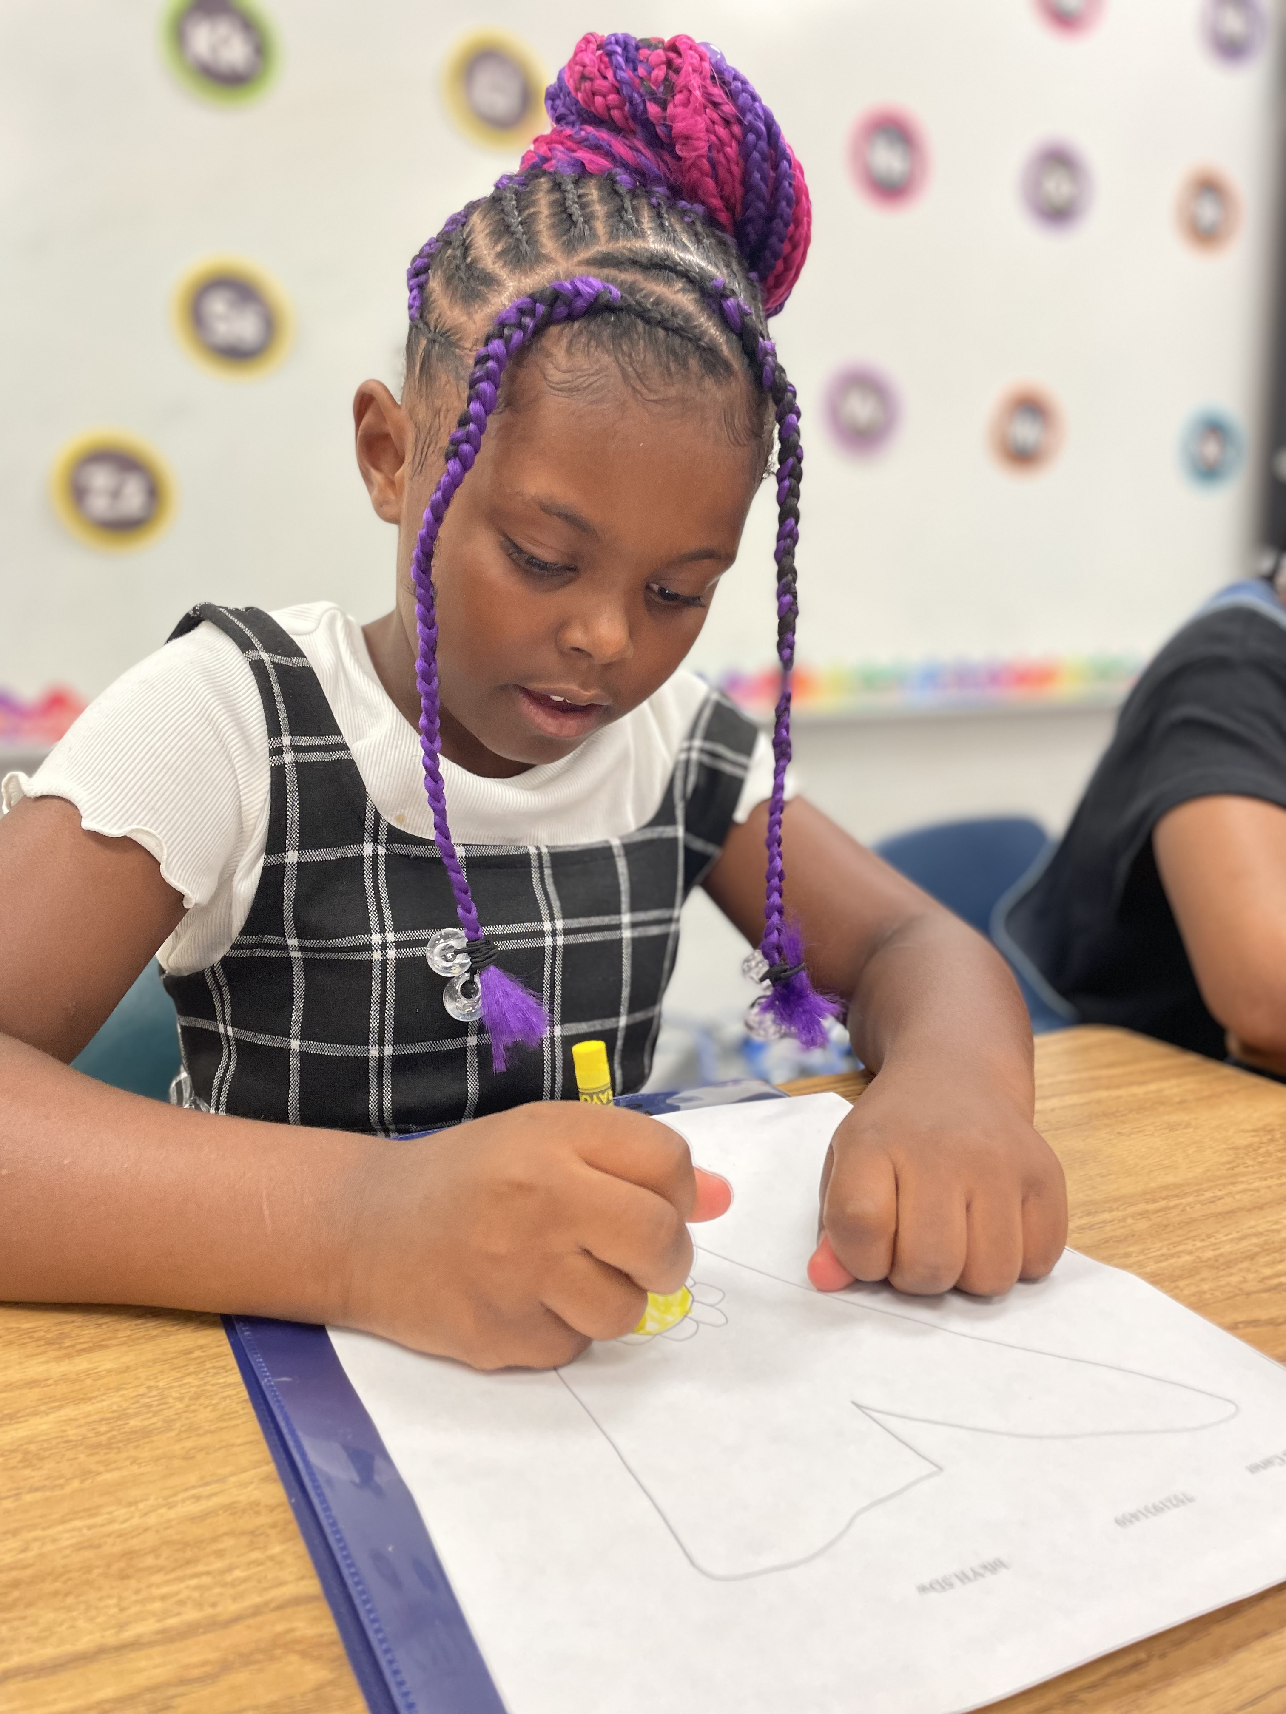
ERATE- Categories
CATEGORY 1 (CAT 1)
The first category of supported services, Category One, includes the services needed to support broadband connectivity to schools and libraries
CATEGORY 2 (CAT 2)
The second category of equipment and services eligible for E-rate support, Category Two, includes the internal connections needed for broadband connectivity within schools.
CHAMPIONS
for Children
2|
with kindness!

Slide 3
ERATE Fillings
CAT 1- $118,000
CAT 2- $114,000
CHAMPIONS
for Children
3|
with kindness!

Slide 4
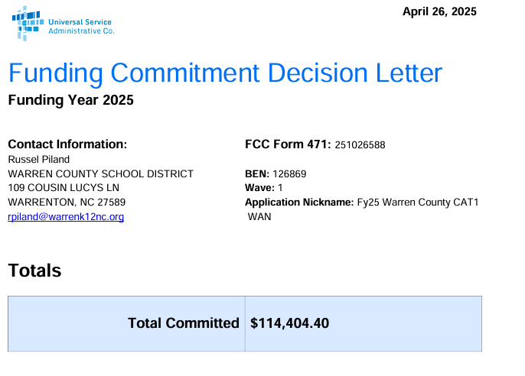
ERATE Fillings
CHAMPIONS
for Children
4|
with kindness!

Slide 5

ERATE Fillings
CHAMPIONS
for Children
5|
with kindness!

