Slide 1

High School Football field Sound System Equipment Install
Board of Education Meeting
March 25, 2025
Dr. Carol Montague-Davis
Interim Superintendent
Russel Piland
Technology Director
CHAMPIONS
for Children
with kindness!

Slide 2
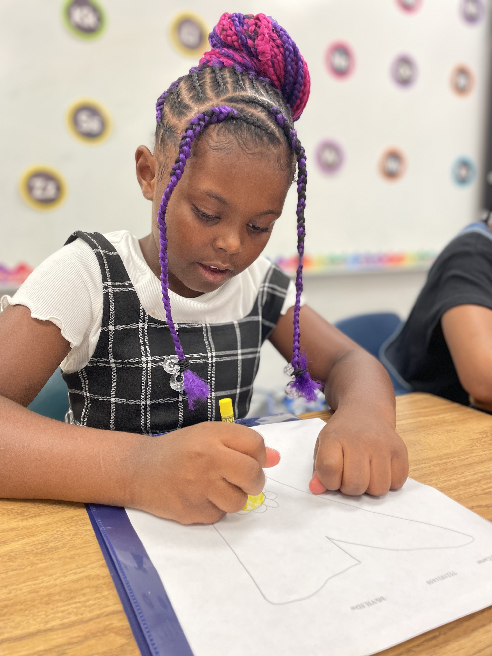
Installation Of Equipment
-Trench 18" and install 246' 3/4" NM electrical conduit for speaker wires -Mount 2 speakers on poles, 1 on press box.
-Locate under ground wiring for trenches
-Pull 14/2 wiring to each speaker
Cost $3010.00
CHAMPIONS
for Children
2|
with kindness!

Slide 3

Installation Of Equipment
CHAMPIONS
for Children
3|
with kindness!

