Slide 1

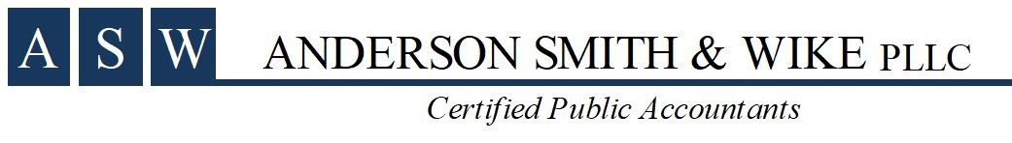
Board of Education of Warren County Schools
June 30, 2024
Audit Presentation

Slide 2
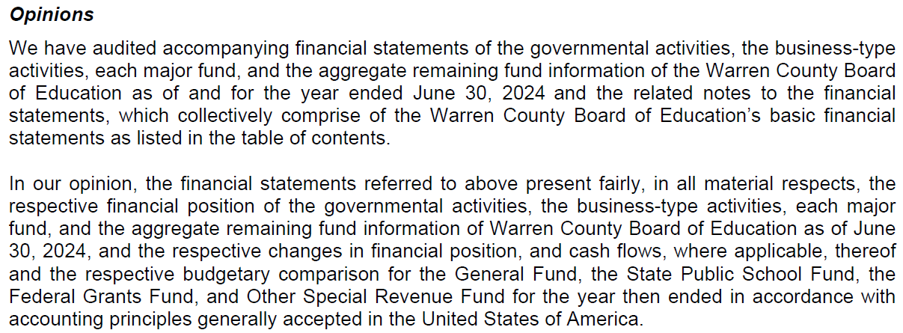
Opinion - Unmodified (Clean)

Slide 3
Required Communications to the Board of Education
  Significant Accounting Estimates
    Depreciation
    Pension and other post-employment benefit (OPEB) liability
  Misstatements
    None
  Disagreements or difficulties with management
    None
Separate Letter

Slide 4
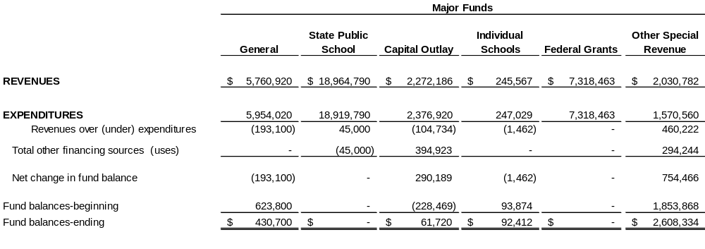
Governmental Funds Statement of Revenues, Expenditures and Changes in Fund Balance
Audit Report: Page 15

Slide 5
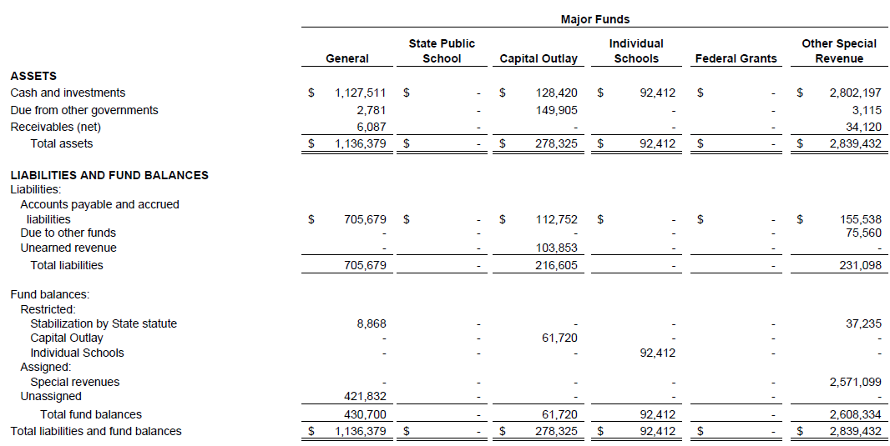
Governmental Funds Balance Sheet
Audit Report: Page 14

Slide 6
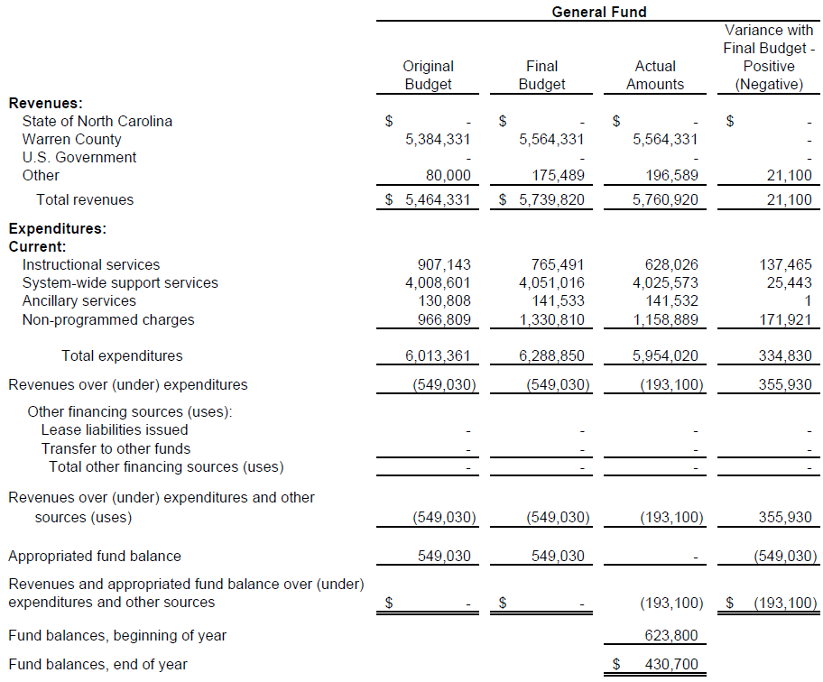
Budget vs. Actual
Audit Report: Page 17

Slide 7
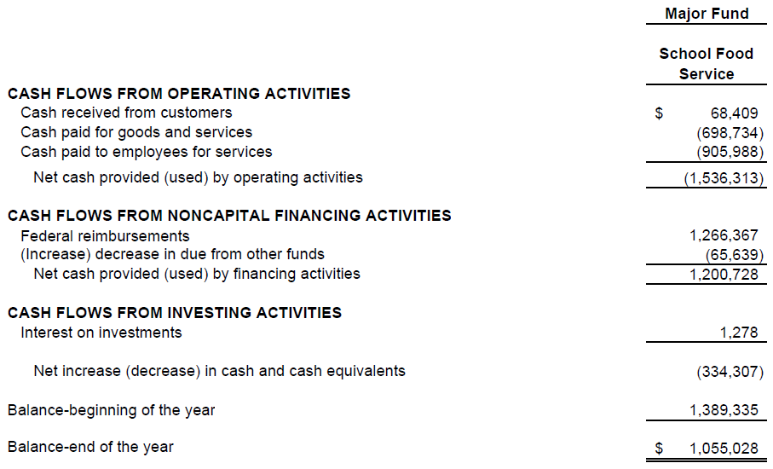
Child Nutrition
Audit Report: Page 23

Slide 8
Communications of Internal Controls - Definitions
  Material weakness — A deficiency or combination of deficiencies in internal control, such that there is a reasonable possibility that a material misstatement of the entity’s financial statements will not be prevented, or detected and corrected on a timely basis.
  Significant deficiency — A deficiency or combination of deficiencies in internal control that is less severe than a material weakness, yet important enough to merit attention by those charged with governance.

Slide 9
Audit Findings & Questioned Costs
  Financial Statements
    2024-01 (Material Weakness)
      While testing expenditures, it was determined that employee timesheets were not reviewed for appropriate hours worked, and compensation the employees received.
        Warren County Schools did not have accurate timesheets for some employees to determine if compensatory time has been appropriately accrued or compensatory time, other leave, or pay was appropriately deducted.
  Federal Awards
    None
  State Awards
    None
Audit Report: Page 75

Slide 10
Management Letter
  Purchase Orders
    We noted the District had several purchase orders that were dated after the vendor invoice date. We recommend the District ensures purchase orders are entered into the accounting system and funds encumbered prior to placing orders for goods and services to avoid exceeding the board approved budget.
  Timeliness of Payments
    We noted the District had several invoices paid substantially after the vendor due date, and invoices that had not been paid as of out field work in October 2024 for goods and services performed during fiscal year end June 30, 2024.
Separate Letter

Slide 11
Management Letter
Continued…
  Child Nutrition Indirect Cost
    We noted the District charged the Child Nutrition program approx. $76,000 more than the maximum allowable amount that could be charged. This amount is recorded as a payable back to the Child Nutrition program. We recommend the District closely monitor the charging of indirect cost to federal programs to ensure that only allowable amounts are charged.
  Annual Leave
    We noted the District is not consistently adjusting annual leave balances when employees transfer their leave to other districts, the retirement system, or resign and the allowable time has passed.
Separate Letter

Slide 12
Supplementary Information

Slide 13
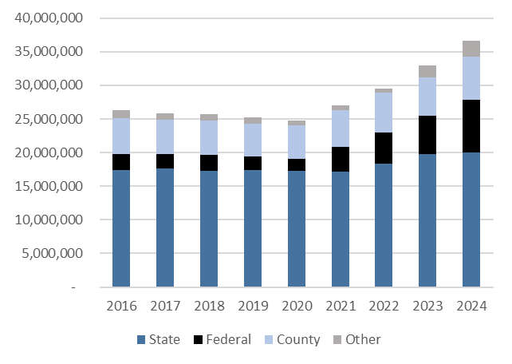
Revenue over time

Slide 14
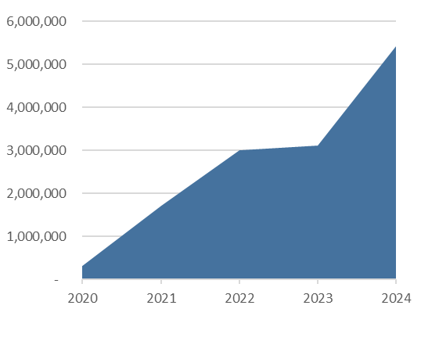
COVID-19 Related Revenue
Remaining Funds as of 6/30/24: $830,000

Slide 15
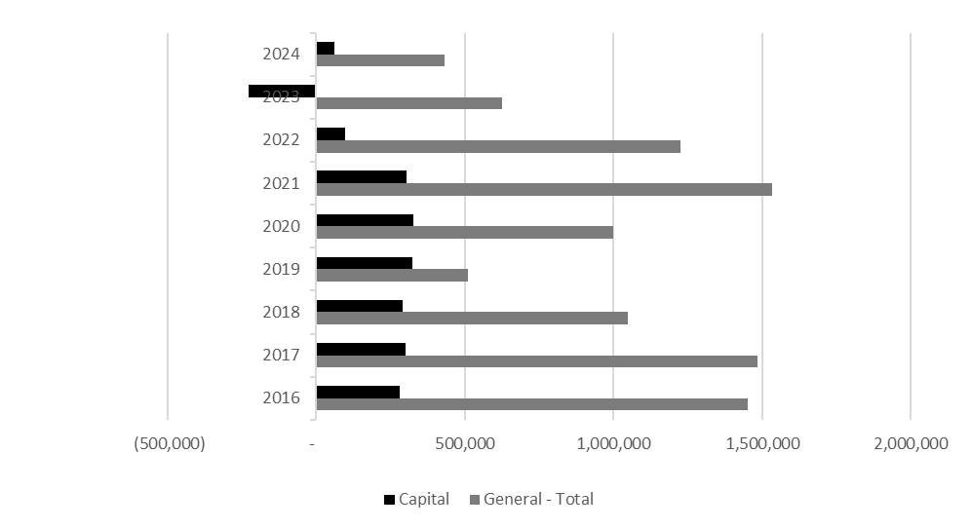
Local Fund Balance over time

Slide 16
Shannon Dennison, CPA
336-380-4123
sdennison@asw-cpa.com

