Slide 1

Edmentum
Board of Education Meeting
August 27, 2024
Dr. Carol Montague-Davis
Interim Superintendent
Marcus Jones
Interim Chief Academic Officer
CHAMPIONS
for Children
with kindness!

Slide 2
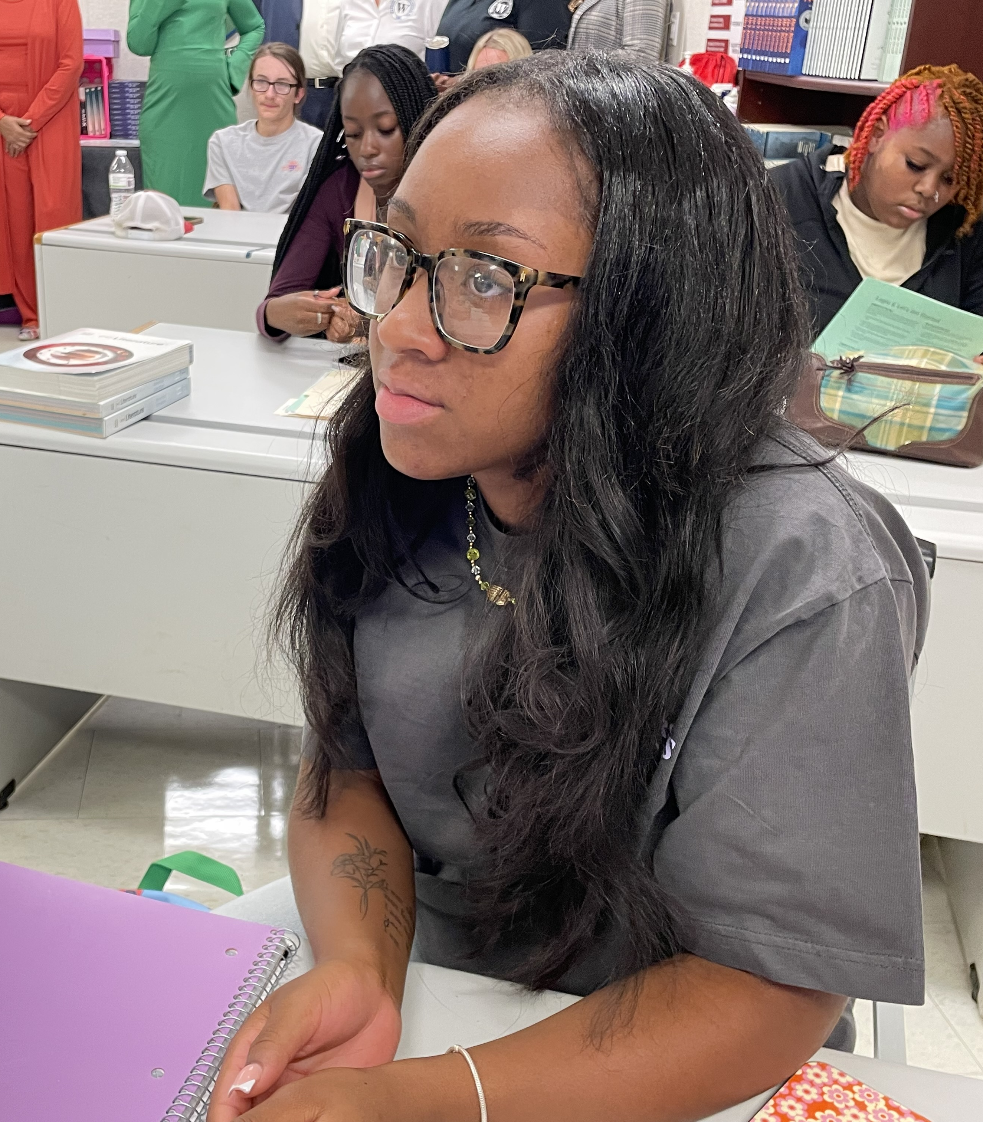
Edmentum Courseware
Broad Curriculum
Offers various subjects and grade levels, covering everything from core subjects like math and science to electives.
Flexible Learning
Students can learn at their own pace or follow a teacher-led schedule, making it easier to fit learning into their routine.
CHAMPIONS
for Children
2|
with kindness!

Slide 3
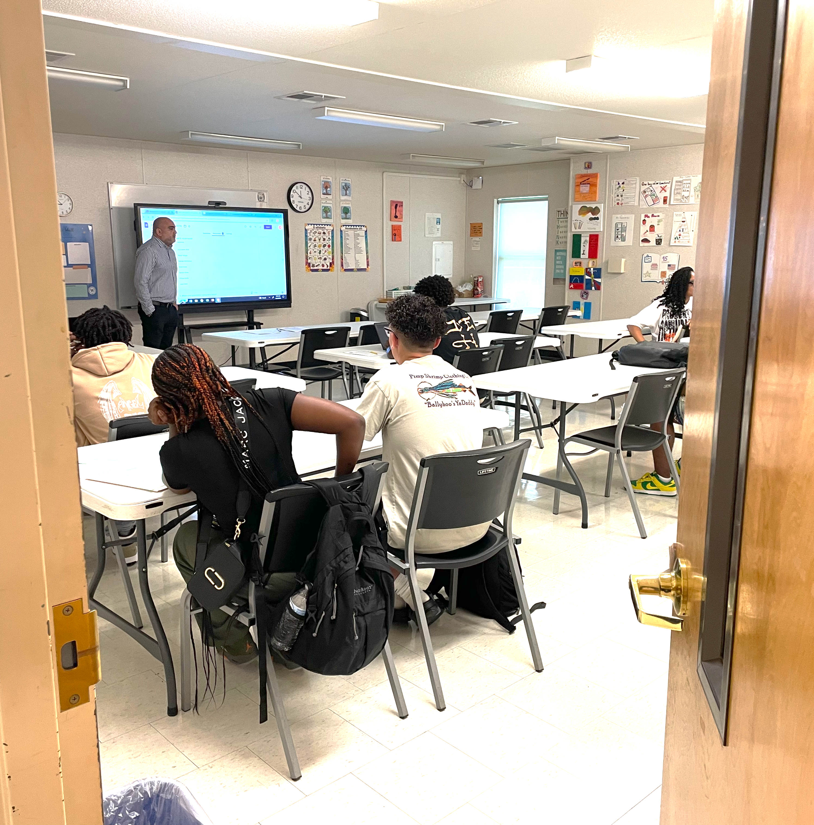
Edmentum Courseware
Engaging Lessons
Uses interactive videos and activities
to make learning fun and relevant.
Progress Tracking
Provides detailed reports on how
students are doing, helping teachers
understand what each child needs to
improve.
Anytime, Anywhere
Accessible from any device with internet so that students can learn from home or on the go.
CHAMPIONS
for Children
3|
with kindness!

Slide 4
Edmentum Study Island
Standards-Based Practice
Helps kids practice skills that match what they need to learn in school and prepare for tests.
Interactive Activities
Includes fun, interactive exercises to keep kids engaged and make learning enjoyable.
Progress Tracking
Allows parents and teachers to see how well students are doing and where they might need extra help.
CHAMPIONS
for Children
4|
with kindness!

Slide 5
Edmentum Study Island
Motivating
Features game-like elements and rewards to encourage students to keep working hard.
Customizable
Teachers can adjust activities to fit each student’s needs, making learning more effective
CHAMPIONS
for Children
5|
with kindness!

Slide 6
Edmentum Exact Path
Personalized Learning:
Creates a learning plan based on what each student knows and needs to learn, helping them progress at their own pace.
Focused Help
Provides extra practice in key subjects like reading and math, focusing on areas where each student needs the most support.
Progress Tracking
Shows how students are improving over time, so teachers and parents can see their growth and adjust support as needed.
CHAMPIONS
for Children
6|
with kindness!

Slide 7
Edmentum Exact Path
Fun Activities
Uses engaging, interactive lessons to keep students interested and motivated.
Easy to Use
Simple for both students and parents to navigate, making it easy to integrate into daily learning routines.
CHAMPIONS
for Children
7|
with kindness!

Slide 8
Questions?
CHAMPIONS
for Children
8|
with kindness!

