Slide 1

Operations Update
Board of Education Meeting
September 10, 2024
Dr. Carol Montague-Davis
Interim Superintendent
Dr. Dennis Carrington
Chief Operations Officer
Mr. Don Mizelle
Director of Maintenance
Mr. James King
HVAC Technician
CHAMPIONS
for Children
with kindness!

Slide 2
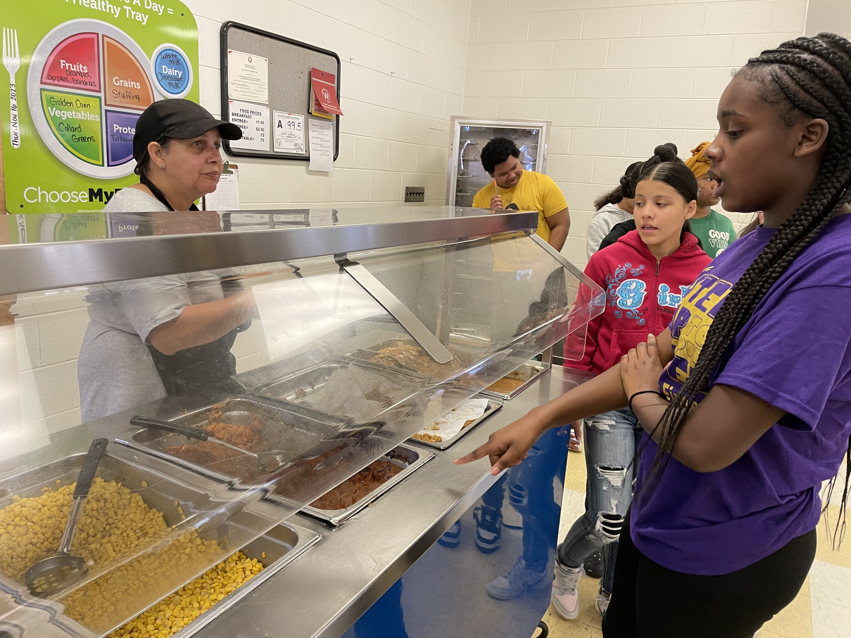
Operations Updates
Building Technologies Division of Siemens Industry Inc.
CHAMPIONS
for Children
2|
with kindness!

Slide 3
Siemens Service Agreement Contract
(8hrs) Online support to minimize downtime and reduce costs
Training for your facility staff
(6 days) technicians on-site visits for Automation Controls Analysis & Optimization to increase efficiency, provide energy savings, and minimize equipment wear.
Repair and replace service coverage for updated Panels and AEM Modules
CHAMPIONS
for Children
3|
with kindness!

Slide 4
Siemens Service Agreement Contract
Quality Assurance interview to ensure services are being delivered to your complete satisfaction
Database backup to ensure safe storage of critical information and your system
Mariam Boyd: 35 controllers
Northside: 32 controllers
Warren New Tech: 22 controllers
Warren County High: 36 controllers
Warren County Middle: 42 controllers
Vaughan Elementary:32 controllers
Contract 07/01/2024-06/30/2025
$35,450
CHAMPIONS
for Children
4|
with kindness!

Slide 5
Questions?
CHAMPIONS
for Children
5|
with kindness!

